Slide 1
Research Methodology
University of South Alabama
Cardiorespiratory Care
CRC 415

Slide 2
Course Outline
Why study research?
The research question and hypotheses
Evidence-Based Medicine and Outcomes Research
Library use and review of the literature
Experimental designs
Data analysis and statistics
Statistics for nominal, ordinal, and continuous measures
Results and discussion sections of research
Publishing
Ethics and the institutional review board

Slide 3
Research Defined Defined
Research is the studying of a problem in pursuit of a definite objective through employing precise methods, with due consideration to the adequate control of factors other than the variable under investigation and followed by analysis according to acceptable statistical procedures.

Slide 4
Why Study Research?
Research determines almost everything that is practiced now in in the future
Provides an opportunity to explore, understand, and explain practice
Enhance clinical career and patient outcomes
You must understand the process to interpret the literature
Incorporation of new treatments depends on the ability to interpret the data
Research must be evaluated to determine best treatment options

Slide 5
Importance of Research
Basis for practice of the profession
Applied to every patient
Analysis allows practitioners to interpret results so they may be applied to patient care; differentiate between conflicting results; determine what is best and useful for patients
Occurs in the laboratory, classroom, office, practice, and society at large
Provides answers that allow for efficient use of time and expertise
Requires systematic data gathering, analysis and interpretation

Slide 6
Myths about Research
Mysterious process, difficult to understand
No connection between research and practice
Done only by introverts
Boring
No relation to the real world
Not what we do in clinical practice

Slide 7
Things Thought to be True in Respiratory Care
IPPB is useful in most patients to prevent pulmonary complications following surgery
Inhaled corticosteroids are of no use in children with asthma
A high PaCO₂ is to be prevented in patients receiving mechanical ventilation
12-15 cc/kg is the appropriate tidal volume for patients on mechanical ventilation with ARDS

Slide 8
Research, Students, and Practitioners
Part of the task of discovery and learning
Essential to learn to interpret the medical literature
Comparable to critical thinking and clinical reasoning
Encourages lifelong learning
Helps practitioners learn how to learn
Imperative to interpret and apply research in care

Slide 9
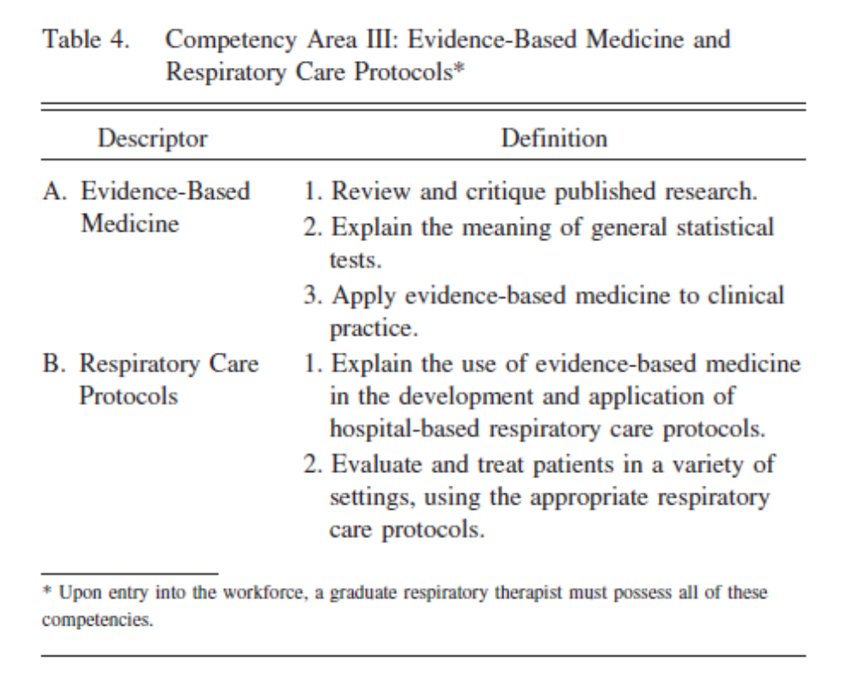

Required Research Competencies

Slide 10
Phases/types of research
Basic research: Seeks new knowledge and furthers research in an area of knowledge rather than attempting to solve an immediate problem; research into how the brain works or explanation of inflammatory pathways; usually performed in a lab with animals or cell cultures.
Applied research: Seeks to identify relationships among facts to solve an immediate practical problem; research to determine if a therapy is practical or safe; may be performed on an animal or mechanical model. Use of a new mode of ventilation.

Slide 11
Phases/types of research
Clinical investigation: systematic evaluation of the application of research findings in the clinical setting on a small group of patients. Does a new ventilator work as it is supposed to, following animal or mechanical studies.
Clinical trials: Similar to clinical investigations, only in a very large group of patients; done by drug companies to check the efficacy of a new drug, after clinical investigation

Slide 12
Phases/types of research
Demonstration and Education: The creation of new educational methodologies, adaptation of existing methodologies to RT, and the evaluation of their effectiveness; may be applied to student and/or patient education. Example: PBL in RT.
Product evaluation: Studies to evaluate the effectiveness of a new piece of equipment, or compare it with existing devices. May be done using mechanical models or patients.

Slide 13
Developing a Research Project/Problem
Understand what is expected
  Syllabus for CRC 450/451
Feasibility
  Assess personal attributes, interests and expectations
  What can you do with the resources you have?
  Can you collaborate?
  Time

Slide 14
Investigate the Feasibility of Your Proposed Study
1. What is the significance or potential benefit of knowing the answer? So what?
2. What are the variables and are they measurable?
3. How long will the project take and how much time do you have?
4. Are there patients, animals, or devices available?
5. Where will equipment and funding come from?
6. Do you have the knowledge and experience to do this project?
7. Is your project ethical?

Slide 15
Developing a Research Project/Problem
Blessing & Forister Method
  Make a prioritized list then determine what’s feasible
  Make another list of things that are important to the profession
  Merge the lists and determine feasibility: what survives?
  Develop a timeline consistent with the time you have
  Get started
Other method
  What are you interested in?
  Ask people
  Read the literature
  Make a list and determine feasibility

Slide 16
How is the Topic Selected?
The work environment
Interest in a particular problem
Literature
Studies can be replicated the same or with a different age group, disease group or set of devices
Mentor, teacher, or preceptor interest
A previous student project
Graduation requirements
Preliminary literature review
  Has the question been answered?

Slide 17
Developing a Problem Statement
Foundation of the study design
Must be defined in a format that allows for successful study
Dictates the concepts and methods used to collect the data
Determines the context in which the conclusion will be interpreted
What is the question to be answered?
Keep it simple

Slide 18
The Research Question
Keep it simple
Given a problem, what can be done, or what approach should be taken to improve it?
What is known about the problem?
What is not known about the problem?
What information or data are needed to improve the situation?

Slide 19
Formats to Ask the Question
Null Hypothesis format
  There are no differences as a result of implementing a procedure among the experimental groups
Alternative hypothesis format
  There is a difference as a result of implementing a procedure among the experimental groups
Research question format
  Asks if there is a difference as a result of implementing a procedure among the experimental groups

Slide 20
Which Format to Use?
Research question
  Broad, can be used for most studies
Null and alternative hypothesis
  Stronger in their specificity and better define the relationship between variables
  Require a statistical analysis
All variables need to be identified
  Independent, dependent, nuisance
Variables need to be measurable

Slide 21
Stating the Research Question
Null Hypothesis | Alternate (Directional) Hypothesis | Research question
No relationship between the variables | There is a relationship (+ or -) between the variables | A question that needs to be answered
“There is no effect of Xopenex on change in FEV₁ beyond that of generic albuterol in patients with moderate COPD” | The use of a ventilator bundle in intubated, mechanically-ventilated patients, including oral care, sulcrafate, and positioning decreases the incidence of airway-associated pneumonia, versus the incidence in a control group not receiving the ventilator bundle. | What are the opinions of baccalaureate versus associate degree respiratory therapy students on reading and interpreting the medical literature as a practice-change agent?

Slide 22
Narrowing the Focus of the Question
Problem statement
Question (problem converted into a question that can be answered)
Aim/purpose of the research project
Objective (what the researcher will do to answer the question); most specific

Slide 23
Question Ideas
What are the physiologic effects of _________?
Does this _______ function as the manufacturer says it will?
If I change this parameter on the ventilator, what effects will it have?
Is this therapy effective to decrease length of stay or the cost of hospitalization compared to the other therapy?
If I use this new ________, is the outcome improved over the previous model?

Slide 24
Be sure your problem statement is very precise
Imprecise: Does the patient do better after we use a spacer with his MDI?
Precise: In children 5-11 years old, is there a significant improvement in peak flow following albuterol MDI use with a spacer versus not using a spacer?

Slide 25
Evidence Based Medicine (EBM)
& Outcomes Research
Definition
The practice of EBM
Hierarchy of evidence
EBM process
Metrics for a diagnostic test
Metrics for a therapy
Meta-analysis
Outcomes research

Slide 26
Historically, clinicians relied on the wisdom of:
sages
texts
oral and written traditions
what has always worked
inappropriately reviewed literature
resulting in an expedient, but often ineffective or inappropriate treatment: IPPB, CPT, mucomyst lavage, etc.

Slide 27
What is EBM?
EBM is an approach to practice and teaching that integrates pathophysiologic rationale, caregiver experience, and patient preferences with valid and current clinical research evidence. Most of the weight is given to the results of rigorous research.

Slide 28
To practice EBM:
Practitioners change their way of thinking about clinical problem solving
Place a lower value on authority unsupported by empirical evidence
Decision making requires careful examination of the evidence
Uses a set of formal rules, applied in an explicit manner
Requires the judicious application of research findings in the patient context
Requires a sense of the availability of resources, and an understanding of the values of those involved in the clinical decision

Slide 29
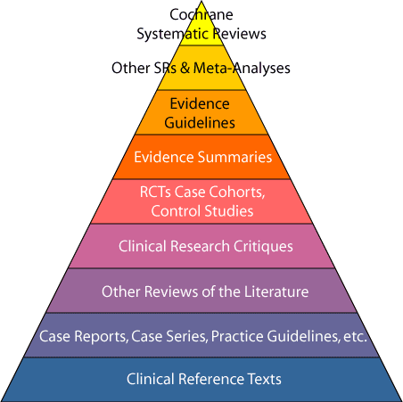
Hierarchy of Evidence

Slide 30
Cochrane Database for Systematic Reviews
Gold standard for use in EBM
Rigorous process for identifying studies to include
Evaluates study strengths and weaknesses
5,000 reviews and 2,000 protocols
EBM/EBP databases: USA Biomedical Library
Evidence based healthcare EBM/EBP databases Cochrane Library

Slide 31
Meta Analysis
Summations of similar studies to draw a unified conclusion
Strongest when the studies are RCTs
Quantitative method
Four step method: literature review, calculation of effect size for each study, determination of a composite effect size, calculation of a failsafe number to assess the certainty of composite size

Slide 32
Randomized Clinical Trials
Random assignment of patients
Increased sample size increases the strength of the argument
Blinding further increases the strength of the treatment
Typical drug study

Slide 33
Systematic Reviews of Observational Studies
Patients are allocated based on their or the clinician’s preference
Blinding is not possible
Results of these studies often coincide with the results of RCTs
Oxygen therapy during exercise increased exercise tolerance and dyspnea in COPD

Slide 34
The Process of EBM Research
Formulating the Question
  pertinence to your practice
  process relies on a clear question (PICO)
  focus the question on the patient’s needs

Slide 35
PICO
Patient or problem
Intervention, prognostic factor, or exposure
Comparison
Outcomes

Slide 36
Gathering the Evidence
EBM reviews-ACP Journal Club
  www.acponline.org
Clinical Evidence
  www.clinicalevidence.org
Cochrane Library
  www.cochranelibrary.com
Medline at OVID
Agency for Healthcare Research and Quality
  www.ahrq.gov
Evidence-based Guidelines
  http://www.rcjournal.com/cpgs/

Slide 37
EBM Metrics for a Diagnostic Test
True/false positives and negatives
Specificity and sensitivity
Likelihood ratio
Positive and negative predictive value
Diagnostic accuracy

Slide 38
True/false positives and negatives
True positive: reference standard and test result are positive
True negative: reference standard and test result are both negative
False positive: test result is positive, but reference standard is negative
False negative: test result is negative, but reference standard is positive

Slide 39
Sensitivity and Specificity
Sensitivity: the ability of a test to correctly identify patients with the condition of interest.
  “If the patient has the condition, how likely is she to have a positive test?”
Specificity: the ability of a test to correctly identify patients who do not have the condition.
  “If the patient does not have the condition, how likely is she to have a negative test?”

Slide 40
Likelihood Ratio
Likelihood that a positive diagnostic test would be expected in a patient with a disorder of interest compared to the likelihood that the same result would be expected in a patient without the condition
1 means no difference
>1 increases the probability that the target condition is present
< decreases the probability that the condition is present

Slide 41
Positive and Negative Predictive Value
Positive predictive value is the probability that the condition of interest is present when the test is positive
Negative predictive value is the probability that the condition of interest is absent when the test is negative
These values are effected by the prevalence of the condition of interest, unlike sensitivity and specificity

Slide 42
Diagnostic Accuracy
The proportion of correct results out of all results
Expressed as a percentage or decimal

Slide 43
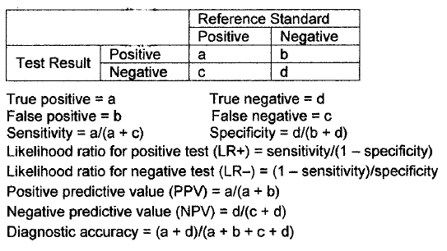
EBM Metrics for Diagnostic Tests

Slide 44
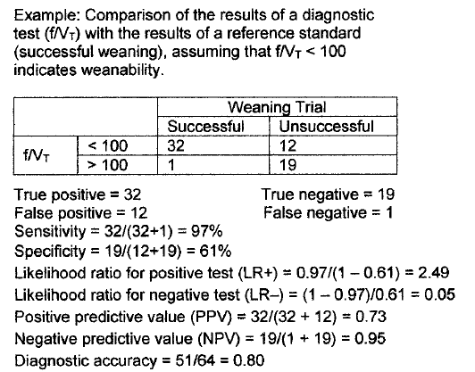

Slide 45
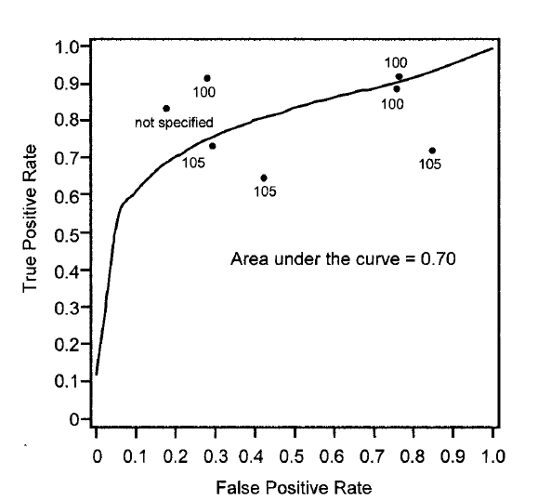
EBM metrics for a diagnostic test
Receiver Operating Curve (ROC): plots the true positive rate against the false positive rate over a range of cutoff values
ROC for the RSBI

Slide 46
EBM metrics for a Therapy
Controlled event rate
Experimental event rate
Relative risk
Relative risk reduction
Absolute risk reduction
Number needed to treat
Odds ratio

Slide 47
EBM Metrics for a Therapy
Controlled event rate: proportion of patients in the control group in whom the event is observed
Experimental event rate: proportion of patients in the experimental group in whom the event is observed
Relative risk: ratio of the risk of an event in the experimental group to that in the control group
  <1 indicates a benefit from the intervention
  >1 indicates harm from the intervention
  1=no effect of the intervention
  If the associated CI does not include 1, it is statistically significant

Slide 48
EBM metrics for a Therapy
Relative risk reduction: estimate of the proportion of baseline risk that is removed by the therapy
Absolute risk reduction: difference in the absolute risk (% of patients with an outcome) in the experimental event rate versus the control event rate
Number needed to treat: number of patients who need to be treated to prevent one bad outcome

Slide 49
EBM metrics for a Therapy
Odds ratio: the ratio of the odds in the experimental group to the odds of the same event in the control group
  OR = 1 means there’s no difference
  OR > 1, the rate of the event is increased in patients exposed to the risk factor
  OR < 1, the rate of the even is reduced
  If the CI of the OR includes 1, it is not significant, because the OR may be 1 indicating no difference

Slide 50
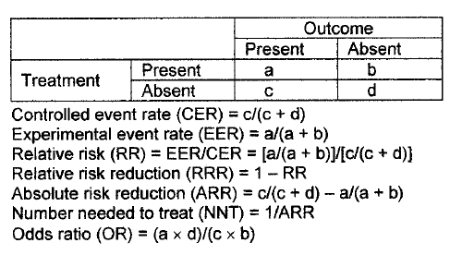

Slide 51
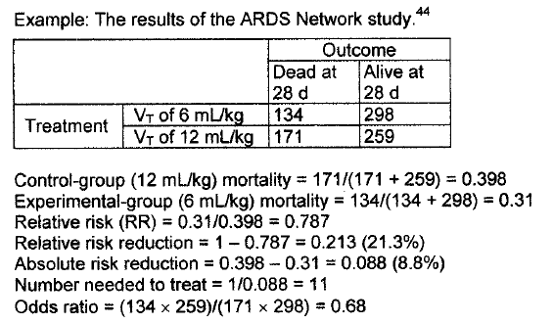

Slide 52
Meta Analysis
A statistical analysis that combines the results of several independent studies
Based on a literature review
Observational
Studies should be comparable
A meta analysis is a higher level of evidence then a single RCT
Often expressed as a forest plot

Slide 53
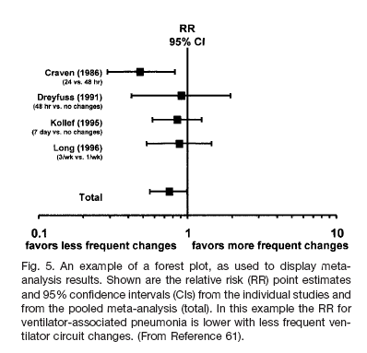

Slide 54
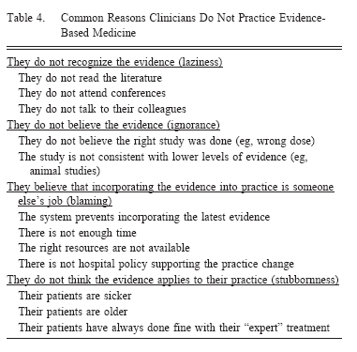

Slide 55
Outcomes Research
Seeks to understand the end results of particular health care interventions
Used to cut nonessential practices and protect those that maintain quality of care
Utilizes EBM
The scientific study of the results of diverse therapies used for particular diseases, conditions, or illnesses with the goals of:
  creating treatment guidelines (i.e. CPGs)
  documenting treatment effectiveness
  Studying the effect of reimbursement policies on outcomes

Slide 56
Outcomes research asks the fundamental questions:
What works?
What doesn’t?
When in the course of an illness does it work or not?
At what cost?

Slide 57
Outcomes Research Jargon
Disease management
systematic population-based approach to identifying patients at risk
intervention with specific programs
measuring outcomes
“There is an optimal strategy for reduced costs and better outcomes. Its emphasis is on identifying populations of interest, creating comprehensive interventions, explicitly defining and measuring outcomes, and providing a strategy for continuous quality improvement.”

Slide 58
Outcomes Research Jargon
Continuous quality improvement
cycle of activities focused on identifying problems or opportunities, creating and implementing plans, and using outcomes analysis to redefine problems and opportunities

Slide 59
Outcomes Research: Focus and Methods
Traditional Clinical Research | Outcomes Research
Disease-centered | Patient and community-centered
Drugs and devices | Processes and delivery of care
Experimental | Observational
Methods from “hard sciences” (e.g., physics, biochemistry) | Methods from “social sciences” (e.g., economics, epidemiology)
Efficacy | Effectiveness
Mechanisms of disease | Consequences of disease on patients
Effects of biochemical and physiologic factors | Effects of socioeconomic factors

Slide 60
Outcome Measures
Clinical
  clinical events (MI, exacerbation, asthma attack)
  physiologic measures (PFTs)
  mortality (Asthma/COPD deaths)
Economic
  direct medical costs (hospital and outpatient visits)
  indirect costs (work loss, loss of productivity)
Humanistic
  symptoms (dyspnea)
  Quality of life (results of questionnaires)
  Functional status (ADL)
  Patient satisfaction (results of questionnaires)

Slide 61
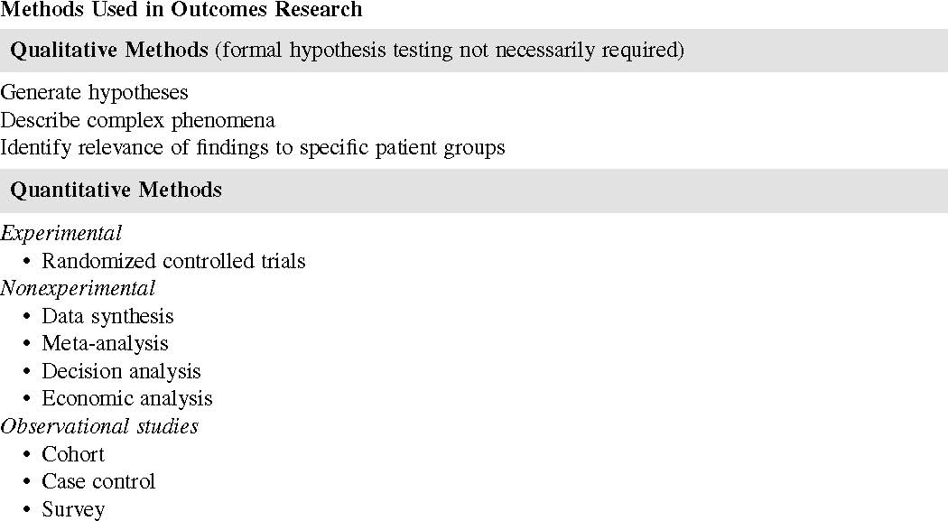

Slide 62
Types of analyses in outcomes research
Decision analysis
  determines optimal strategies when there are several alternative actions and an uncertain or risk-filled pattern of future events
  a model is created in the form of a decision tree
Cost identification
  description of the costs of providing intervention
Cost of illness
  total cost of a disease or disability to society
  heart disease costs $128B/yr
Cost minimization
  two or more interventions are being compared
Other cost-related indices
  Cost effectiveness analysis
  Cost benefit analysis
  Cost utility analysis

Slide 63
Levels of impact of outcomes research
Findings that contribute, but do not alone reflect a change in policy or practice
Findings that prompt the creation of a new policy or program
Findings that change what clinicians or patients do
Actual changes in health outcomes

Slide 64
It has been suggested that Outcomes research, along with its methodologies and core curriculum, be viewed as an important discipline in respiratory care to:
Determine the effectiveness of CQI initiatives
Compare differences in respiratory care practice in order to identify optimum strategies
Develop and assess innovations
Evaluate resource utilization in areas employing respiratory therapists, compared to similar settings without them.

Slide 65
Benchmarking
The use of a standard or point of reference in measuring quality
Next best thing to scientific method, when scientific method cannot be used
Compares your performance to a peer's to see who is most successful
"a continuous process of measuring products, services and practices against one's toughest competitors and renowned industry leaders and learning from them"

Slide 66
Benchmarking Paradigm
Identify critical success factors and determine key indicators
Collect information on the key indicators
Search out extraordinary performers
Identify factors that drive superior performance
Adapt those factors to fit into your process

Slide 67
There are a variety of benchmarking indicators: ratio, process, and outcome
Once data are gathered they are analyzed the same as in a formal research process, a process called gap analysis
Outcomes to acceptance of benchmarking results: denial, rationalization, and learning
Examples of projects used for benchmarking: incidence of VAP, best practices in secretion clearance in CF, absenteeism, missed treatments

Slide 68
Review of the Literature
Attributes of the literature review
What are the resources to use
What databases are available
Writing the literature review
Read literature reviews to understand the format and the language used

Slide 69
A successful literature review should:
Provide an overview of the available literature on the study topic
Help determine what is known about the study topic
Identify areas of controversy
Identify areas of weakness in existing research
Help formulate questions regarding further research
Provide research tools/instruments

Slide 70
Characteristics of the Literature Review
Large, well-referenced section of a thesis or dissertation (chapter 2)
Provides a solid basis for evaluating and understanding the depth and breadth of the research investigation
Provides information with which the reader can contrast the results and conclusions of the current research
Becomes the basis for the discussion section of the current research
  That which is the second section of the proposal becomes the basis of the discussion section

Slide 71
Where to Start?
A carefully-worded research question or hypothesis helps the researcher
  Choose the best resources and key words
  Avoid wasting time

Slide 72
Selecting Resources
Books
  Help define terms
  Establish the state of practice
  Identify authorities
Professional journals
  Provide primary information
  Scholarly, peer-reviewed
  Use online bibliographic databases
Use the librarian

Slide 73
Medline: “Ovid” or “Pubmed”
Links to biomedical information
Uses a controlled vocabulary of Medical Subject Headings (MeSH), “key words”
  Can be combined with AND and OR to get precise results
Authors’ names may be searched
Limits
  Age
  Range of years
  Language
  Type of publication
  Etc.

Slide 74
Other Databases
CINAHL
  Allied health and nursing
  May not be peer reviewed, but may provide education and management literature
Google Scholar
  Retrieval ranked by where the article was published, author, and frequency of citation
  Records of dissertations
  Advanced feature limits: specifies words or phrases, author, source, date, pdf availability

Slide 75
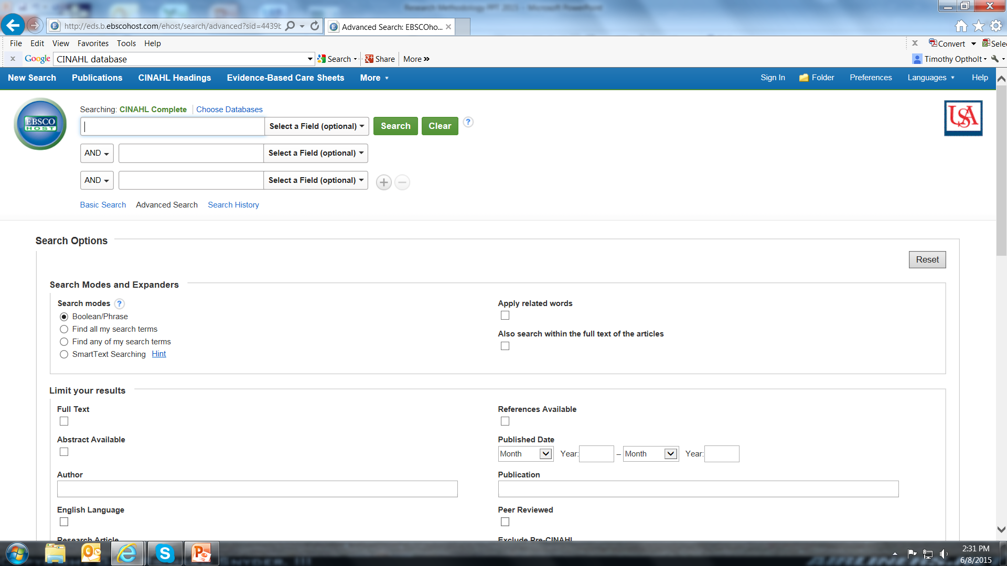

Slide 76
Other Database
Education Resources Information Center (ERIC)
  Papers on educational issues
  Provides a comprehensive, easy-to-use, searchable, Internet-based bibliographic and full-text database of education research and information for educators, researchers, and the general public
journal articles
books
research syntheses
conference papers
technical reports
dissertations
policy papers, and
other education-related materials

Slide 77


Slide 78
Writing the Literature Review
Summarize each paper
  Read all the papers and determine the main outcomes of the studies
  Prepare an outline of those outcomes
  Summarize the papers
  In a study of topic or n subjects with disease or disorder, author found that there was a difference/not a difference (p= X) in the dependent variable when the independent variable was used/changed.
  Describe their findings and conclusions
  Make your conclusions
  When preparing the manuscript of your project, make this the body of your discussion

Slide 79
Evidence-based practice and information literacy skills for cardiorespiratory therapy
Clista Clanton, MSLS, AHIP

Slide 80
Evidence-based practice
Evidence-Based Practice (EBP) requires that decisions about health care are based on the best available, current, valid and relevant evidence. These decisions should be made by those receiving care, informed by the tacit and explicit knowledge of those providing care, within the context of available resources.
Dawes, M., Summerskill, W., Glaszion, P., Cartabellotta, A., Martin, J., Hopayian, K. et al. (2005) Sicily statement on evidence-based practice. BMC Medical Education, 5. Retrieved 7/22/09 from http://www.biomedcentral.com/1472-6920/5/1

Slide 81
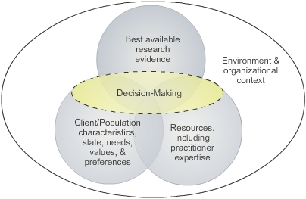
Adapted from: Sackett D.L., Rosenberg M.C., Gray J.A., Haynes R.B., Richardson W.S. (1996).
Evidence based medicine: what it is and what it isn't. BMJ, 312, 71-72.

Slide 82
Background Questions
Background questions ask for general information about a condition or thing.
  A question root (who, what, when, etc) combined with a verb.
  A disorder, test, treatment, or some other form of healthcare.
    What are the causes of COPD?
Background questions are typically answered by textbooks.

Slide 83
Foreground Questions
Foreground questions ask for specific knowledge about a specific patient with a specific condition.
  Do patients intubated in the field experience higher rates of hospital-acquired pneumonia than those who are intubated after hospital admission?
Foreground questions are typically answered
by databases that access the research
literature found in journals

Slide 84
Background vs. Foreground
Foreground
Background
Experience with Condition

Slide 85
Developing the question
  Foreground questions usually have four components.
P = Patient/population/problem
I = Intervention
C = Comparison with other treatments
O = Outcome

Slide 86
PICO: Components of an answerable, searchable question
Patient population/disease | The patient population or disease of interest - age - gender - ethnicity - with certain disorder (e.g., hepatitis)
Intervention | The intervention or range of interventions of interest - Exposure to disease - Prognostic factor A - Risk behavior (e.g., smoking)
Comparison | What you want to compare the intervention against - No disease - Placebo or no intervention/therapy - Prognostic factor B - Absence of risk factor (e.g., non-smoking)
Outcome | Outcome of interest - Risk of disease - Accuracy of diagnosis - Rate of occurrence of adverse outcome (e.g., death)
Melnyk, B. M., & Fineout-Overholt, E. (2005). Evidence-based practice in nursing & healthcare : A guide to best practice. Philadelphia, PA: Lippincott Williams & Wilkins.

Slide 87
Types of questions
Diagnosis: How to select a diagnostic test or how to interpret the results of a particular test.
Prognosis: What is the patient's likely course of disease, or how to screen for or reduce risk.
Therapy: Which treatment is the most effective, or what is an effective treatment for a particular condition.
Harm or Etiology: Are there harmful effects of a particular treatment, or how these harmful effects can be avoided.
Prevention: How can the patient's risk factors be adjusted to help reduce the risk of disease?
Cost: Looks at cost effectiveness, cost/benefit analysis.
Qualitative: Helps to understand clinical phenomena with emphasis on understanding the experiences and values of patients.

Slide 88
Question Templates for Asking PICO Questions
Therapy
In __________________, what is the effect of ____________________ on
______________________ compared with __________________?
Etiology
Are ______________ who have _________________ at ________________
risk for/of ____________________ compared with _____________________
with/without ______________________?
Diagnosis or Diagnostic Test
Are (Is) _________________________ more accurate in diagnosing
________________ compared with ________________?
Prevention
For _________________ does the use of _______________ reduce the future risk of ________________ compared with _________________?
Prognosis
Does _______________ influence _________________ in patients who have
__________________?
Meaning
How do _______________ diagnosed with _______________ perceive ___________?
Melnyk, B. M., & Fineout-Overholt, E. (2005). Evidence-based practice in nursing & healthcare : A guide to best practice. Philadelphia, PA: Lippincott Williams & Wilkins.

Slide 89
Type of Question | Suggested Best Type of Study
Therapy | RCT > cohort > case control > case series
Diagnosis | Prospective, blind comparison to gold standard
Etiology / Harm | RCT > cohort > case control > case series
Prognosis | Cohort study > case control > case series
Prevention | RCT > cohort study > case control > case series
Clinical Exam | Prospective, blind comparison to gold standard
Cost | Economic analysis
Questions of therapy, etiology and prevention which can best be answered by RCT can also be answered by a meta-analysis or systematic review.

Slide 90
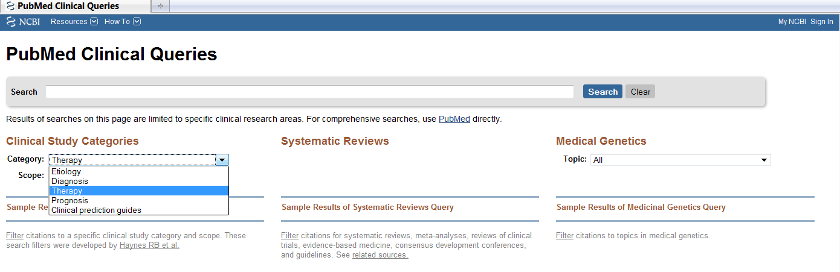
PubMed Clinical Queries

Slide 91
Evidence Pyramid
Start at the top and work your way down.
Meta-analysis/Metasynthesis
Systematic Review
Randomized Controlled Trial
Cohort Studies
Case Control Studies
Case Series/Case Reports
Animal Research

Slide 92
Healthcare Literature
Primary – original research
  Experimental (an intervention is made or variables are manipulated)
    Randomized Control Trials
    Controlled trials
  Observational (no intervention or variables are manipulated)
    Cohort studies
    Case-control studies
    Case reports
Secondary – reviews of original research
  Meta-analysis/Metasynthesis
  Meta-synthesis
  Systematic reviews
  Practice guidelines
  Reviews
  Decision analysis
  Consensus reports
  Editorial, commentary
Not used in EBP

Slide 93
Levels of Evidence
Type of Evidence
I. Meta-analysis of multiple well-designed controlled studies.
II. Well-designed experimental studies.
III. Well-designed, quasi-experimental studies, such as nonrandomized controlled, single-group pre-post, cohort, time series, or matched-case controlled studies.
IV. Well-designed nonexperimental studies, such as comparative and correlational descriptive and case studies.
V. Case reports and clinical examples.
Strength and Consistency of Evidence
A. There is evidence of type I or consistent findings from multiple studies of types II, III, or IV.
B. There is evidence of types II, III, or IV, and findings are generally consistent.
C. There is evidence of types II, III, or IV, but findings are inconsistent.
D. There is little or no evidence, or there is type V evidence only.
Panel Consensus: Practice recommended based on the opinions of experts in pain management.

Slide 94
Systems
Computerized decision support
Summaries
Dynamed,
First Consult, EBP guidelines
Adapted from
Haynes (2001)
Synopses
Evidence-Based Nursing, TRIP
ACP Journal Club
Syntheses
Cochrane Systematic Reviews, DARE
Studies
PubMed, CINAHL, Scopus
Haynes RB. Of studies, summaries, synopses, and systems: the “5S" evolution of services for finding current best evidence. ACP Journal Club. 2001;134: A11–13.

Slide 95
Searching for evidence
  Twenty-one percent of all patients with COPD are readmitted within 30 days of discharge,^{1,2} and costs for these readmissions are 18% higher than for initial stays.¹ This high prevalence and cost make COPD an important target of Centers for Medicare and Medicaid Services (CMS) policies designed to reduce readmissions. Thus far, the CMS strategy for reducing readmissions has focused primarily on incentivizing improvements in inpatient care and discharge planning. For example, the Hospital Readmission Reduction Program penalizes hospitals with higher than expected rates of readmission for specified conditions. These inpatient-focused strategies have not produced consistent reductions in readmissions.
Databases and other sources to search:
  Dynamed
  Clinical Key
  Cochrane Library
  PubMed
  CINAHL
  Scopus

Slide 96
Designing the Experiment: Methodology
Methods section
Bias and error
Reliability and validity
Types of studies
Experimental designs
Quasi-experimental designs

Slide 97
Methods Section
Describes how the study was conducted
Must be clear and detailed enough to allow replication
Sections
  Subjects
    How selected, inclusion and exclusion, power study
  Instrumentation
    Equipment, calibration, setup, survey or test instrument, medications
  Procedures performed
    Survey/method, therapy,
  Data analysis
    Statistics, metrics, α value for significance

Slide 98
Concepts of Research Design
Variable: an entity that can take-on different values; that which is measured to determine changes that answer the research question or address the hypotheses
  pressure, volume, flow, opinion, scores on anything
Independent variable: the variables that is manipulated, aka treatment variable
Dependent variable: a variable that is measured, that may change as a result of the treatment
Nuisance variables: extraneous variables that are difficult to control that can effect the dependent variable
Placebo: a fake or sham treatment

Slide 99
Controlling Bias
Control of factors that could confound the results, unrelated to the manipulation of the independent variable
The reader must be able to conclude that the researcher’s bias did not influence the study
Allows the results of the study to truly represent manipulation of the independent variable
Declaration of COI
Even spread of extraneous variables: age, gender, pack years, disease severity

Slide 100
Error
Observed measurement = true measurement + error
As error decreases, the observed measurement becomes closer to the true measure
Random error
  Errors because of chance
  Small sample size
  P value quantifies acceptable error
Systematic error
  Series of consistent biases
  Poor technique, inappropriate protocols or research designs, incorrect measurements or statistics

Slide 101
Reliability
Consistency with which a measurement is taken
Instrument reliability
  Does the instrument provide the same result each time the same thing is measured? Improved with calibration
Intrarater reliability
  When one individual measures the same phenomenon repeatedly, is the result the same? Follow protocols and be consistent, use a scoring rubric
Interrater reliability
  If more than one rater is observing, are the observations the same? Protocol and practice rule; κ statistic

Slide 102
Validity
Does the measuring tool actually measure the trait that it is intended to measure?
The usefulness or appropriateness of the data being gathered
Measurement or test validity
  Face: does the measurement or method appear to be appropriate?
  Construct: degree to which the measurement is based on theory
  Content: is the test broad enough to address the scope of the content

Slide 103
Measurement or Test Validity
Criterion validity
  How well the test performs and whether it is useful when judged against a standard
    Predictive validity: whether and how well a test predicts a specific phenomenon or outcome
    Concurrent validity: does a new or different test perform as well as an accepted test?

Slide 104
Design or Experimental Validity
Internal
  Limiting or controlling factors and events other than the independent variable
    Even distribution of extraneous variables
External
  Factors effecting the generalizability of the data
    Addressing only the research question
    Don’t stray by inferring that your results effect subjects other than those included in your study
      Animals to humans
      One age group to another
      In vitro to in vivo

Slide 105
Threats to Internal Validity
Threats that effect the validity of the study itself
  Temporal
    History: passage of time; maturation: the subject ages and can do things better because they are older, attrition: subjects prematurely leave the study
  Measurement
    Testing: repeated testing may allow the subject to become test-wise
    Instrumentation: Problems with measurement instruments
    Sampling error: representativeness of the population, number, randomization
    Regression to the mean: tendency of outliers to move towards the mean

Slide 106
Threats to External Validity
Threats related to the population used
  The sample is different from the population to which one wishes to generalize
  Subject-treatment interaction
    Confounding effects of the subjects’ attributes on the dependent variable
    Genetic makeup, lifestyle, severity of illness, mental ability, psychomotor skill
  Carefully sample from the population
  Select-out confounding features by being specific with inclusion and exclusion criteria

Slide 107
Threats to External Validity
Threats related to environment and the experiment
Description of the variables
  Carefully describe variables (pulmonary function parameters, laboratory values, cognitive tests)
  Improves reproducibility
Multiple treatments involving test order
Hawthorne effect
  Subjects change their behavior joust because they know they are being studied
Rosenthal effect
  A change in the results because the investigator becomes involved in the study

Slide 108
Types of Studies
Descriptive
  Data are numerical or non-numerical
  Non-numerical
    Descriptions, interviews
    Qualitative
  Numerical (quantitative)
    Statistical summaries reporting differences
    Correlative studies
    Studies reporting descriptive statistics
      Measures of central tendency
      Measures of variability

Slide 109
Types of Studies
Analytic
  Differences between groups
    Use of inferential statistics (t-tests, analysis of variance, etc.)
  Relationships among variables
    Correlative studies (how does a variable trend with another variable?)
  Both

Slide 110
Types of Studies
True experimental
  Prospective,
  Random sampling, control of variables, manipulation of independent variables
Cross-sectional: a snapshot of subjects at one period
Case-control: study of a sample of subjects for those with and without a disease to determine factors responsible for the disease
Cohort study: identify people who have and don’t have a risk factor and examine the two groups over time to identify those who develop the disease or condition

Slide 111
Types of Studies
Prospective
  Data collection is planned in advance
  True experiments and concurrent cohort studies
  Better control of variables
  Valid and reliable measurement methods
  Potential problems
    Cost
    Extrapolation of results from tightly controlled studies to the general population
Retrospective
  Examines data already gathered
  Chart reviews, case control studies
  Inexpensive, a large quantity of data may be available, large n

Slide 112
Types of Data
Nominal Data
  Characteristic names with no numerical value
  Male/female, black/white, smoker/nonsmoker
Ordinal data
  Comparative, can be ordered by rank
  Likert scales
Continuous data
  Interval
    Numerical values between units, but no zero point
    Temperature
  Ratio
    Numerical values between units and a zero value
Data type determines statistic

Slide 113
Experimental Designs
Conventions for an experimental design
R=randomization
M=matched
X, with or without subscript=treatment
X_{O}=no treatment or placebo
O=measurement or observation
Dashed line=nonequvalency

Slide 114
True Experimental Designs: 3 Characteristics
Manipulation of an independent variable
Control of extraneous variables
  random selection of sample and random assignment to groups: random or chance assignment can be expected to even-out nuisance variables
  matching of subjects between groups or grouping of subjects based on a nuisance variable: subjects are used as their own controls
  inclusion of a nuisance variable as a treatment (independent) variable
  statistical removal of a nuisance variable through analysis of covariance
Observation of a change in the dependent variable

Slide 115
Pre-experimental Designs
Weak and subject to threats
Lack a control group
Sensitive threats to temporal validity
Poor generalizability

Slide 116
Pre-experimental Designs
One-shot case study
  XO
  Treatment is given and a measurement is made
  Typical of surveys
  Teach a class, give a test
  Descriptive studies

Slide 117
Pre-experimental Designs
One group pretest-posttest
OXO
Make a measurement, give a treatment, remeasure
Vulnerable to temporal threats to internal validity
Difficult to generalize because the group may not be representative (not randomized)

Slide 118
Pre-experimental Designs
Static group comparison
XO
_ _ _ _
O
1 Group has received a treatment, the other no treatment
Not randomized, therefore the groups are not equivalent
Some factor other than the treatment may cause the results

Slide 119
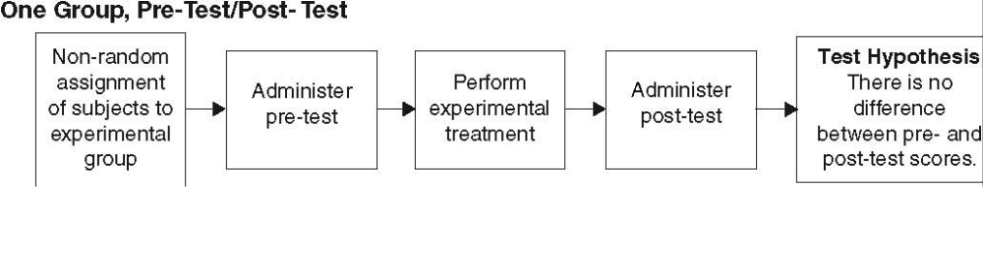
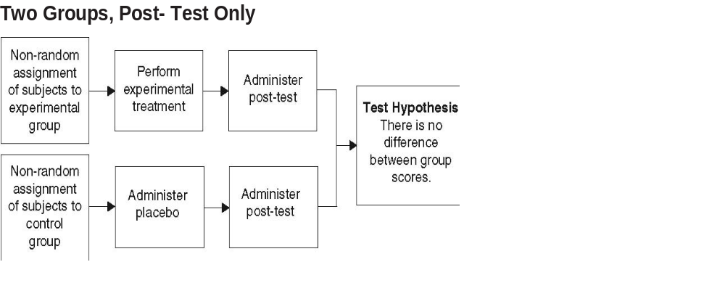
Pre-Experimental Designs

Slide 120
True Experimental designs
Randomization
Control group
Independent variables are manipulated
Confounding variables are equally distributed
  Ttests and other tests of equivalency show no difference between groups in these traits

Slide 121
True Experimental Designs
Pretest, posttest, control group design
R O₁ X_{O} O₂
R O₁ X₁ O₂
Rules-out most threats to internal and external validity
“gold standard” for RCTs
Control group is either no treatment, a placebo, or the conventional or “predicate”
Subjects often blinded

Slide 122
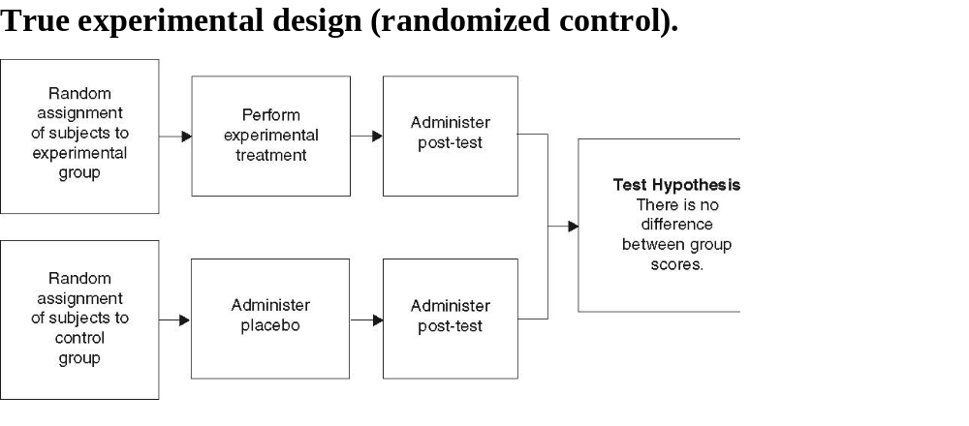
True Experimental Design

Slide 123
True Experimental Designs
Posttest only control group design
R X_{O} O
R X₁ O
Pretest is inappropriate or unavailable

Slide 124
True Experimental Designs
Solomon four group design
R O₁ X_{O} O₂
R O₁ X₁ O₂
R X_{O} O₂
R X₁ O₂
Combination of two previous designs
Determines if the effect occurs due to the pretest
Requires twice as many subjects

Slide 125
Quasi-experimental Designs
More rigorous than pre-experimental designs
Not as rigorous as true experimental designs
Lack one or more of the characteristics of a true experimental design
  Randomization, manipulation of independent variable, control group

Slide 126
Quasi-experimental designs
Nonequivalent control group design
  Groups are not randomized
  O₁ X_{O} O₂
  O₁ X₁ O₂
Separate sample pretest-posttest design
O X
_ _ _
X O
Used when the pretest may bias the results

Slide 127
Quasi-experimental Designs
Time series
O₁ X_{O} O₂ O₃ O₄
O₁ X₁ O₂ O₃ O₄
Groups are compared to each other and there are multiple subsequent measurements of the dependent variable
Repeated testing threatens validity
Groups may be nonequivalent

Slide 128
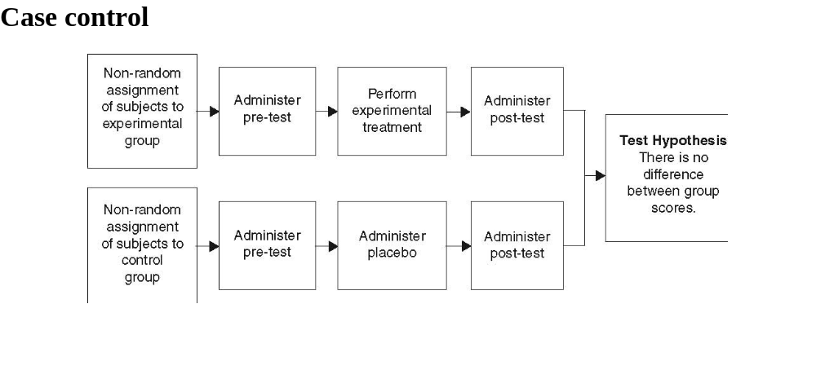
Quasi-experimental

Slide 129
Survey Research
What surveys do/don’t do
Types/Planning/Response rate
Introduction
Follow-up
Types
Item construction
Demographics
Survey instruments
Pilot testing
Subjects
Data analysis

Slide 130
Surveys
DO:
Provide demographic information
Opinion
Preferences
Expectations
Knowledge
Outcomes
Don’t DO:
Establish causality

Slide 131
Types of Surveys
Mail
Telephone
Interview
Email
Comparison of methods in B&F Table 7-3
Consider the characteristics of survey type when planning

Slide 132
Survey Planning
Define what is to be achieved in the study
What is the goal?
Generate the research question or hypothesis

Slide 133
Response Rates
Tend to be low
Carefully define target population and sample
Appropriate cover letter
Careful survey design
Keep it short
Inducement?
Provide for a follow-up
Begin with interesting questions
Use graphics when appropriate
Use capital or dark letters

Slide 134
Survey Introduction
Presented at the beginning – seen first
Put in the body of the email
Read if the survey is face-to-face or telephone
Subject should understand the purpose and need for their input
Concise, well-written, informative
Grammar and vocabulary appropriate – middle school
Proofread!
Pilot test
IRB approval & person to contact

Slide 135
Follow-Up Notices
Reminders to complete and return the survey
Assure subjects that their responses are private and protected
Provide the link to the survey, or send it again
10-14 days after initial solicitation
May be set to everyone, or if coded, to the non-responders

Slide 136
Types of Surveys
Web-based
  Most common
  Distributed by email containing a link to the survey: Survey Monkey and others
  Sample size can be large
  Large amount of data can be collected
  Results are often automatically downloaded to a database
  Incorporate attractive photographs or illustrations
  Cost is only the hosting fee
  Limitations
    Low response rate, misinterpretation of survey items, respondents must have a computer

Slide 137
Types of Surveys
Telephone
  Personal contact
  Move through survey based on responses
  Items may be clarified
  Limitations
    Cost
    Interviewers must be trained
    As length increases, so do hang-ups

Slide 138
Types of Surveys
Interview
  Occur where people are
  Scheduled appointments work best
  Requires contact between the interviewer and the subject
  Voice inflections and body language are important
  Interviewers must be trained
  Limitations
    Time and cost

Slide 139
Survey Item Construction
Responses must provide data to answer the research question
Purpose must be defined

Slide 140
Survey Item Construction
Demographics
  Provide the basis for comparisons between groups
  Define and identify the study sample
  Age, gender, occupation, practice parameters, patient types
  Ask for a direct response, rather than a range; group later
  If using ranges, make sure they don’t overlap
  Avoid asking for the same data in more than one question
  Short, to the point questions
  Ask only for information relevant to the study
    Know ahead of time what you’ll do with each data point
    Relevant to the research question

Slide 141
Survey Instrument
Items that provide the data for the investigation
Items must be short, clear, exact, understandable and answerable
Is a survey already available that addresses your RQ?
Brainstorm a significant list, then edit delete, combine, categorize and develop specific items that address the RQ
Format
  Structured (closed response)
  Unstructured (open-ended)
Try to eliminate interpretation errors

Slide 142
Survey Instrument
Ranking questions
  Ensure the ranking numbers are defined (like the affective assessment)
  Specify if all items should be ranked
  Make sure instructions are very clear
  Consistent format
Likert scales
  Ordinal scale used to gather opinions
  Strongly agree to strongly disagree
  Ensure the question can be answered by the scale used
  An item must address only one idea or concept
  Equal number of positive and negative response choices

Slide 143
Putting the Survey Together
Introduction
Organize questions so items are grouped
Demographic questions are often put last, so they are easily answered after the survey has been finished
Ensure the method of submission is clear
Proofread, have someone else proofread

Slide 144
Pilot Testing
Allows for question clarification, understandibility
Are there too many items?
Time needed too long?
Items clear, concise and easy to understand?
Responses appropriate for the item?
Directions understandable?
Does the survey provide the data sought by the RQ?
Any bias or leading questions?
Is the format visually pleasing?
Are there suggestions for improvement?

Slide 145
Number of Subjects
If the population is small, survey all
Sampling:
  Convenience
  Stratified
  Random
Consider cost
May be calculated using sample size programs, based on Confidence level (usually 95) and Confidence interval
  http://www.surveysystem.com/sscalc.htm

Slide 146
Samples and Populations
Population: entire collection of cases as defined by a set of criteria
Accessible population: the population available to the investigator
Target population: the population to which the research results are intended to be generalized

Slide 147
Sample
Samples are used to save time and money
Measurements from a sample can be generalized to the target population
Important to assure that the sample represents the target population

Slide 148
Sampling Rules
Populations are defined by the researcher and must be clearly specified
Populations need not be large in number
Accessible population must be clearly described, since the accessible population determines the true target population
Sample size effects the precision of estimates. Correct sample size increases the probability for correct research conclusions even with small sample sizes

Slide 149
Sampling Methods
Non probability samples: non-random sampling, convenience or accidental sample
  The first 20 cases that meet inclusion criteria
Probability sampling: based on random selection; essential for the use of inferential statistics to test hypotheses
  Relies on methods of random sampling

Slide 150
Methods of Random Sampling
Simple random sampling
  every unit in the population has an equal chance of being selected
  number every unit in the population, then use a table of random numbers
Stratified sampling
  used when the population needs to be subdivided
Systematic sampling
  random sample where the population is N and the desired sample size is n and the sample interval is K, the sample size is N/n, and the sample is randomly started at K
Cluster sampling: random selection of intact groups within a population of groups

Slide 151
Statistics
Descriptive
  Mean, median, mode, standard deviation, percentages
Correlation
  Pearson’s r, Spearman’s
Inferential
  Ttests, regression, McNemar’s, etc.

Slide 152
Data Analysis
The practitioner must be able to critically analyze research to make decisions regarding diagnosis and therapy
  Know the types of data
  Know how to use and interpret statistical tests
  Know when to choose a given statistical test or know that it is appropriate

Slide 153
Levels of Measurement
Nominal data
  Responses are in named groups or categories
  Gender, race, category of severity, RRT/CRT
  Descriptive analysis
    Contingency table, frequencies, metrics for a diagnostic test
  Correlation (kappa and phi)
  Single sample with population
    Binomial test, Z test
  Two samples of unmatched data
    Fisher exact test
  Two samples of matched data
    McNemar test
  Three or more samples of matched data
    Chi squared test

Slide 154
Levels of Measurement
Ordinal data
  An ordering or ranking between variables
  Distance between variables is not defined
  Subjects indicate degree of agreement/disagreement
  Likert scales
  Verbal frequency scales
    Always, sometimes, never

Slide 155
Statistics for Ordinal Data
Descriptive analysis
  Contingency table, frequencies, CI
Correlation and prediction
  Spearman rank order correlation
Two samples unmatched data
  Mann-Whitney rank sum test
Two samples matched data
  Wilcoxon signed rank test
Three or more samples unmatched data
  Kruskall Wallace ANOVA
Three or more samples, matched data
  Friedman repeated measures ANOVA & all pairwise multiple comparison procedure

Slide 156
Continuous Data
Interval data
  Ordering of data points
  Distance between each points in the same
  No absolute zero
  Centigrade and Fahrenheit
Ratio data
  Ordering of data points
  Distance between each points in the same
  There is a zero point
  Most all numeric measurements, such as test scores, physical measures

Slide 157
Statistics for Continuous Data
Descriptive
  Contingency table, measures of central tendency, measures of dispersion, CI
Correlation
  Pearson product moment correlation (r), simple and multiple linear regression
Single sample with population
  One sample t test
Two samples unmatched data
  Unpaired t test
Two samples matched data
  Paired t test

Slide 158
Statistics for Continuous Data
Three or more samples, unmatched data
  One way ANOVA
  Two-way ANOVA
  Post-hoc test
Three or more samples, matched data
  One way and two way repeated measures ANOVA
  Post hoc test
Normality of data spread
  Kolmogorov-Smirnov test
Equality of variance test
  F ratio test

Slide 159
Descriptive Statistics
Summarizes data as a first step, followed by inferential statistics
Measures of Central Tendency
  Mean
    Sum of scores divided by the total number of scores
    Continuous data only
  Median
    Midpoint of ordered scores
    Ordinal or continuous data
  Mode
    Most frequently appearing score
    Nominal, ordinal or continuous data

Slide 160
Median
Median
  50th percentile of the observations
  Odd n = middle observation
  Even n = sum of two middle values/2
  Uses the values of the observations
  Divides the observations in half
4,5,6,6,7,7,8 mL
Median = middle observation (6 mL)
3,4,5,5,6,8,9,9
Median = average of the middle observations (5.5 mL)

Slide 161
Mode
  Most frequently occurring value
  In a normal distribution, there is usually one mode
  Multimodal distributions are also possible
3,3,4,4,4,5,5,5,5,6,6,6,7,7
Mode=5

Slide 162
Descriptive Statistics
Measures of Variability
  Range
    Difference between the highest and lowest scores
    Does not include all the data
  Standard deviation (SD or S)
    Most important
    Square root of the variance
    Variance = sum of the squared differences between each score and the mean, divided by the number of scores – 1
    Reported with the mean (mean + SD)
  Standard error of the mean
    SD divided by the sqrt of n

Slide 163
Inferential Statistics
Tests null hypotheses
Select a significance level called α
  usually .05
Data analysis yields a p value
  Probability that the observed result could occur by chance if the null hypothesis is true
  If p<α, the null hypothesis is rejected: there IS a difference
  If p>α, the null hypothesis is retained: there IS NOT a difference

Slide 164
Choosing a Statistical Test
Determine data type
Parametric or nonparametric?
  Parametric assumes a normal distribution and equal variance
  KS test and F test are passed
  Parametric are usually for continuous data
  If the distribution is not normal for continuous data, use the nonparametric equivalent
  Nonparametric statistics are used for ordinal and nominal data
  Nonparametric tests not as “powerful”

Slide 165
Choosing a Statistical Test
Determine if results are paired or matched
Paired
  Same sample is measured after an intervention
Matched
  Characteristics of the experimental group are matched to that of the control group
    T tests between control group and experimental group result in p>.05
Unpaired
  Dissimilar groups

Slide 166
Choosing a Statistical Test
Number and type of variables
Two variables
  Two means: t tests or nonparametric equivalent
  > two means: ANOVA or nonparametric equivalent
What is being explained
  Relationships
    Correlation
  Difference
    T test or ANOVA

Slide 167
Statistics for Nominal Measures
Nominal measures (variables) are those that simply have numerical labels, but no numerical values. Examples are a count of the number of males and females, or doctors, lawyers and indian chiefs.
Summarized in terms of proportions, percentages, ratios, and rates.

Slide 168
Applicable Statistics
Contingency table
Proportion (decimal), %, ratios
Odds, OR
+ likelihood ratio, + predictive value
True/false positives and negatives
Sensitivity and specificity
Diagnostic accuracy
Receiver operating curve

Slide 169
Correlation for Nominal Variables
Since there are no values to the variables, the usual definition of correlation does not relate to nominal variables.
However, one can determine if the scores of one group of people correlate to another group’s, called reliability.
1. If I ask the question, “if I measure the same thing twice, will I get the same result?” this is intrarater reliability
2. If I ask the question, “If different people look at the same result, will they evaluate it the same way?” this is interrater reliability

Slide 170
Kappa (Κ)
Reliability between two persons looking at the same phenomenon; ie blood gases or PFTs
Kappa
construct a contingency table
calculate observed agreement
calculate the chance agreement
calculate Kappa (κ) (not in Excel)
Chance agreement increases as the proportion of one category or another increases

Slide 171
Phi (Φ)
Index of agreement independent of chance
Allows testing of significant difference between raters
Calculated as described (not in Exel)
Interpret as with Kappa
Ranges from -1 (extreme disagreement) to +1 (extreme agreement)

Slide 172
Comparing Two Samples, Unmatched Data
Two independent groups, nominal data
Fisher Exact test
  Data is presented in 2 x 2 contingency tables
  Enter the data as directed by the statistical software
If we set α at 0.05, any p >0.05 tells us that we accept H_{O} (there is no difference)
P<.05 means that there is a difference

Slide 173
Two or More Samples, Matched Data
Patients act as their own control, or two groups are carefully matched for confounding factors
McNemar’s test
  Analysis of contingency tables that have repeated observations of the same individuals
  Must have equal numbers of rows and columns (2x2, 3x3, etc.)
H_{O} = there is no significant difference between the paired proportions before and after treatment
Like the Fisher exact test, any p > 0.05 tells us there is no difference between groups (accept H_{O})

Slide 174
Three or more samples, unmatched data
Chi-Squared Test (Χ²)
  Contingency tables larger than 2x2
  HO = the proportions are equal
  The software reports the power and α
  We usually want power to be > 0.8
  Any p > 0.05 allows us to accept the null hypothesis between the independent variables
  p < 0.05 we reject the null hypothesis

Slide 175
Statistics for Ordinal Data
Data on the ordinal level of measurement consist of discrete categories that have a particular order to them.
Numbers represent relative high and low values of a variable
  Likert scales
  Summarized in terms of percentages, proportions, ratios and rates

Slide 176
Statistics for Ordinal Data
Describing the data
Contingency table
  First step is to create a contingency table
  Displays counts or frequencies
Report percentages of responses
Means of responses should not be reported

Slide 177
Statistics for Ordinal Data
Correlation
Compares sets of ordinal data to determine if one variable trends with another
Spearman Rank Order Correlation
  Spearman’s rho
  Nonparametric test
  Does not require a linear relation among data points, a normal distribution, or constant variance
  Varies from -1 to +1, just like Pearson’s

Slide 178
Spearman’s Rho
Procedure is used when you want to measure the strength of association between pairs of ordinal variables or between an ordinal variable and a continuous variable
The example compares weight (a continuous variable, converted to an ordinal variable) with APGAR score (an ordinal variable)
Not available on Excel
Gives you a correlation coefficient and a p value
  The greater the coefficient, the greater the relationship
  if p is > 0.05, there is no correlation (too many chances to be wrong)

Slide 179
Statistics for Ordinal Data
Comparing two samples, unmatched data
Mann-Whitney Rank Sum Test
  Aka Mann-Whitney U or Wilcoxon Rank Sum Test
  Nonparametric alternative to the unpaired t test

Slide 180
Statistics for Ordinal Data
Comparing two samples, matched data
Wilcoxon Signed Rank Test
Nonparametric equivalent to the paired t test

Slide 181
Statistics for Ordinal Data
Comparing three or more samples, unmatched data
Kruskall-Wallis ANOVA
  Nonparametric equivalent to the one way ANOVA
  Used to see if groups are effected by a single factor
  The hypothesis is that the groups are the same, versus the hypothesis that at least one of the groups is different from the others

Slide 182
Statistics for Ordinal Data
Comparing three or more samples of matched data
Friedman Repeated Measures ANOVA
  Nonparametric equivalent to a one-way repeated measures ANOVA
  Used to see if a single group of individuals was affected by a series of three or more different experimental treatments, where each individual received all treatments
  If there is a difference, use a multiple comparison procedure, such as the All Pairwise Multiple Comparison procedure
    tells if there is a difference between pairs

Slide 183
Statistics for Continuous Measures
Require interval and ratio data
Outline
  Testing for Normality
  Testing for Equal Variances
  Correlation and Prediction
  Comparing One Sample to a Known Value
  Comparing Two Samples of Unmatched Data
  Comparing Two Samples of Matched Data
  Comparing Three or More Samples

Slide 184
Testing for Normality
Sample data must come from distributions that are normally distributed; if not, one of the nonparametric tests must be used
Kolmogorov-Smirnov test
  Tests if the distribution of a continuous variable is the same for two groups
  Compares the distributions at a number of points, then considers the maximum differences between the two distributions (a sample distribution and a normal distribution)
  Influenced by the maximum value in a distribution
  Used with caution if outliers are suspected
  If there is no significant difference (p>0.05) between the sample distribution and the normal distribution, we assume the sample distribution to be normal, and we can use the data in a parametric test

Slide 185
Testing for Equal Variance
Sample data must have equal variances; if not a nonparametric test must be used
F ratio test
  Ratio of two sample variances
  Is the variance of one sample larger, no different, or smaller than the other?
  If the p value of the F test is < 0.05, then we reject the null hypothesis, concluding that the variances are not equal

Slide 186
Correlation and Prediction
Pearson Product Moment Correlation
Pearson r has a value of -1 to +1
Construct a table of data with the value of the dependent variable next to the value of the independent variable
The software reports an r and a p
The higher the r, the better the correlation
A p < 0.05 means that the correlation is significantly different from 0

Slide 187
Correlation and Prediction
Simple Linear Regression
Uses the values of the independent variable x, to predict the value of the dependent variable y, in the form y = b_{o} + b₁x
Software does tests for normality and consistency of variance
Software calculates y intercept and the slope and creates the equation, based on least squares analysis
The R² is calculated, which is the amount of y variable predicted by the x variable

Slide 188
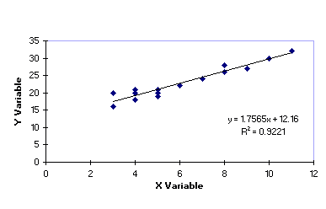
Simple Linear Regression
r = 0.96

Slide 189
Correlation and Prediction
Multiple linear regression
An extension of simple linear regression to multiple independent variables
Logistic regression
  Predicts a qualitative dependent variable, such as life or death, disease or no disease
  Dependent variable must be nominal and dichotomous

Slide 190
Comparing Groups
Did something different occur between groups, due to manipulating the independent variable?
If there is a difference, was it because of chance?
If something non-random occurred, how large was the effect of the difference?
Don’t confuse statistical difference with clinical difference
  There could be a statistically significant difference, but it may make no clinical difference

Slide 191
T-test
Assesses the difference between the means of two unrelated groups or independent samples
The one-tailed t test is used if the researcher hypothesizes that the difference is in one direction
  Since this is not usually known, a two-tailed test is used
  One-tailed test can be used for noninferiority tests
    “not substantially worse”
  Two-tailed is more conservative
Report mean + SD for the two groups & p
Minimum of 15 subjects in each group

Slide 192
Comparing Two Means
One sample t test
Compares a sample mean to a hypothesized population mean
Determines of there is a significant difference between the sample mean and the population mean
If p is >0.05, there is no difference; if p < 0.05, there is a difference between the sample and population
Software computes the mean of your sample, a t value, a p value, and the 95% confidence intervals
Used to compare your sample data with a manufacturer’s claim

Slide 193
Comparing Two Means
Unpaired t test
Compares two samples of unmatched data
Determines if there is a significant difference between two means of different groups, one exposed to the treatment, one not
Software calculates a p value; if it is > 0.05, there is no significant difference; if it is < 0.05, there is a significant difference
The distributions must be normal and have an equal variance; if not, use the Mann-Whitney Rank Sum test

Slide 194
Comparing Two Means
Paired t test
Compares two samples of matched data
Determines if there is a significant difference between two means of paired groups, twins, or subjects used as their own controls; one exposed to the treatment, one not
Software calculates a p value; if it is > 0.05, there is no significant difference; if it is < 0.05, there is a significant difference
The distributions must be normal and have an equal variance; if not, use the Wilcoxon Signed Rank Test

Slide 195
After t test, Determine Size of Effect
aka effect size
Cohen’s d
= mean1 – mean 2
pooled SD
Pooled SD = sqrt SD²1 + SD²2
2
Effect size:
  Small = .2, medium = .5, large = .8

Slide 196
Paired t test
Less variability, so more powerful
Two sets of data collected from the same sample servig as their own control
An intervention occurs between the two measurements
Pretreatment-posttreatment designs
Report means + SD, p, and effect size

Slide 197
Hotelling’s T²
Comparing two groups using multiple dependent variables

Slide 198
Comparing 3 or More Means
One would be tempted to compute three t tests, but the chance of a type I error increases as this is done
Since the type I error increases as you increase the number of pairwise comparisons, the correct test to use when there are more than two means is Analysis of Variance (ANOVA)

Slide 199
One-way ANOVA
Extension of the t test for > 2 means
Software will generate comparisons between groups
P value
  If not significant, there are no differences
  If significant, do a post-hoc test to determine where the significance is
Bonferroni correction: an adjustment of the p value, dividing it by the number of comparisons to decrease chance differences
Other post hoc tests reduce error

Slide 200
One-Way ANOVA, Unmatched Data
Tests the hypothesis that there is no difference among the means of the dependent variables of the groups
If there is a difference, a post-hoc test (such as Tukey’s Honest Significant Difference) is performed on pairs of means to determine where the difference actually is
If the data are not normally distributed or of equal variance, use the Kruskal-Wallis ANOVA on Ranks

Slide 201
> 3 Samples of Matched Data
One way repeated measures ANOVA
Looks at values collected at more than one point in time for a single group of subjects
Used to determine if a single group of subjects are effected by a series of experimental conditions
Followed by a post hoc test if there is a difference
If data are not normally distributed and of equal variance, use Friedman repeated measures ANOVA on ranks
Two way repeated measures ANOVA
Comparing values within and between groups over time periods

Slide 202
Two-Way ANOVA, Unmatched Data
Compares means within groups as well as between groups
There are two experimental factors which are varied for each experimental group

Slide 203
Other ANOVA
Factorial ANOVA
  Includes more independent variables
  Creates a table that is more than 2x2
Repeated measures ANOVA
  More than two measurements of the same variable are taken from a single group over time
MANOVA
  Examination of group differences with multiple dependent variables concurrently

Slide 204
Results Section
All key findings related to the research question
No conclusions or speculation
“just the facts”
Shortest section
Past tense
Must be consistent with the methodology and data analysis
Be neutral
Basis for the interpretation of the meaning
No raw data!

Slide 205
Results Section Text
Begins with a description or profile of the subjects
Relevant demographics
Numbers, percentages and central tendency
Results of statistical analyses
Something is significant only if it is statistically significant
  State the p value
Indicate which hypotheses were supported
  Avoid “proved”

Slide 206
Tables
Show research results
Avoid using the fist sentence to reference a table
Use available commercial programs to create tables
Organize, condense and list numerical data
The analyses performed dictate the display format
Follow “Instructions for Authors”

Slide 207
Table Guidelines
Legend should stand on its own; above table
Number consecutively and use call-outs
Don’t mix sample demographics with inferential statistics
Don’t explain a table in the text – redundant
Publisher’s guidelines (use Respiratory Care)
Avoid excessive lines
Include units of measure
No decoration or decorative text

Slide 208
Figures
Graphs, charts, pictures, computer generated images, diagrams, flowcharts and drawings are “figures”
Graphs include line graphs, scatter graphs, histograms, bar and pie charts

Slide 209
Figure Guidelines
Legend should stand on its own, below figure
Choose the proper type of graph based on the data
Number consecutively and use call-outs
Space and scale elements appropriately
Proofread and check that data were plotted accurately
Watch contrast and pattern
Publisher’s guidelines (use Respiratory Care)
Permissions

Slide 210
Discussion Section
Implications
Limitations
Discussion
Bias considerations
Recommendations
Conclusions

Slide 211
Implications
The meaning of the results
Think critically about the results, draw conclusions, make inferences
What changes are indicated in clinical practice?
What do these results mean to healthcare and society?
Insignificant results confirm practice
Discusses what the results mean in the light of what is known
New approach may be recommended
Author makes the case for the study and its results

Slide 212
Limitations
Addresses the study’s weaknesses
What to avoid if the study is replicated
Putting limitations forward gives credibility
To whom should the findings be generalized
Representativeness and randomness of the study sample

Slide 213
Discussion
Interpretation of the results, implications, study’s limitations
Places the study in the context of the ongoing conversation and context of the current literature
Allows author to give their views in the impact and importance of the findings
Practical application of the research is presented
Discuss novel tools, surveys, statistical methods

Slide 214
Recommendations
The author’s ideas about future research
What’s the next step?
Recommending a new research design
Using a new data collecting instrument
Addressing gaps or weaknesses in the study

Slide 215
Conclusions
Last and brief
Restate the aims of the study and RQ
Major findings of the study
Implications for practice
Share personal opinions

Slide 216
Things to Avoid in the Discussion
Drawing conclusions or formulating implications that cannot be clearly supported by the results
Providing too many recommendations such that the main recommendations are lost
Having an apologetic tone. Be matter of fact.

Slide 217
Summary for Discussion Section
How the findings contribute
Specific implications for practice or society
Describe how the findings fit into the present body of knowledge
State how the findings support, enhance, or contrast with prior findings (one of the reasons you wrote a literature review)
Strong support is needed if findings are novel or inconsistent

Slide 218
Research Article Structure/content
Title
Specific, clear, short
Often composed last
Title page
Title, authors’ names, corresponding address
Phone, fax, email
Organization
Financial disclosure
Statistical consultant
Disclaimers

Slide 219
Research Article Structure/content
Abstract: a summary of the project
What, why, and how
Results with statistics
Conclusions
Drawn from the study
Often all in one paragraph
Limited to N words
Each journal has its own format

Slide 220
Research Article Structure/content
Introduction
Describe the background of the work
Pertinent references
No data or conclusions
STATE THE RESEARCH QUESTION OR HYPOTHESES

Slide 221
Research Article Structure/content
Methods
Selection of patients, controls, or animals
Discuss randomization, blinding
Discuss numbers of subjects and losses
Describe in enough detail to allow others to replicate your work
Refer to established methods
Describe, justify, and evaluate new methods
Report calibration

Slide 222
Research Article Structure/content
Methods section
Drugs
  Identify all drugs and chemicals
  Doses, routes, generic names
Commercial products
  Include model numbers
  Include in a separate section, as directed by the editor
Ethics
  Note human subjects review and institution when applicable
  Note accordance with animal use guidelines when applicable
Data analysis
  Note statistical methods
  Note alpha level

Slide 223
Research Article Structure/content
Results section
Describe experimental groups, devices, or products
Present in logical sequence
Use tables and illustrations; DO NOT repeat data in the text
Report all the results
Avoid saving any results for the discussion section
Report p values
Do not discuss or draw conclusions in this section
just the facts

Slide 224
Research Article Structure/content
Discussion section
Restate the research questions
Emphasize new and important aspects of the study and your conclusions
Compare your work to others
Implications and limitations of the findings
Future study
Avoid making claims about what you did not study
Provide a “take-away” message for the reader in a separate conclusions section or paragraph

Slide 225
Research Article Structure/content
Product sources
Follow the editor’s rules
Acknowledgments
References
Support statements of fact, sources of information
Cite published or accepted materials
Avoid citing abstracts, non-English papers, unpublished observations
Follow established reference style for that journal: AMA or APA

Slide 226
Research Article Structure/content
Tables
Display information, compare data, or show trends
Compose a descriptive title so it stands alone
Use footnotes to explain abbreviations and symbols
Figures
Graphs, line drawings, photographs, and radiographs
Pie, bar, scattergrams, 3D, and line charts are common
Captions should clearly describe the figure so it stands alone

Slide 227
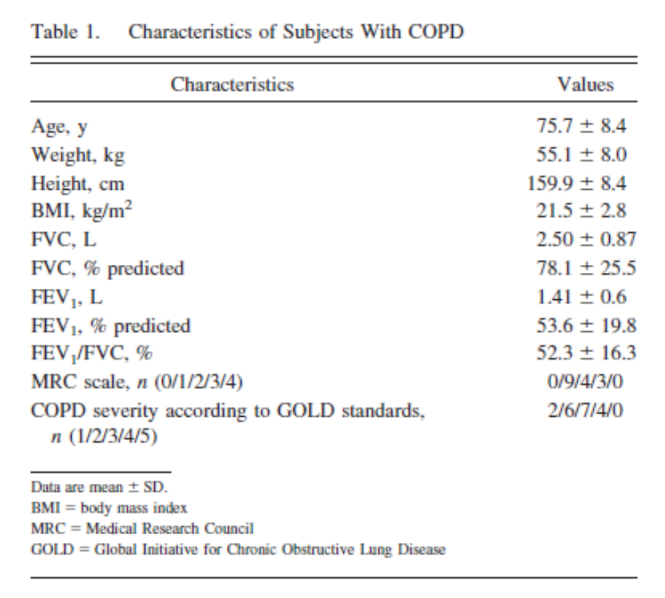
Table

Slide 228
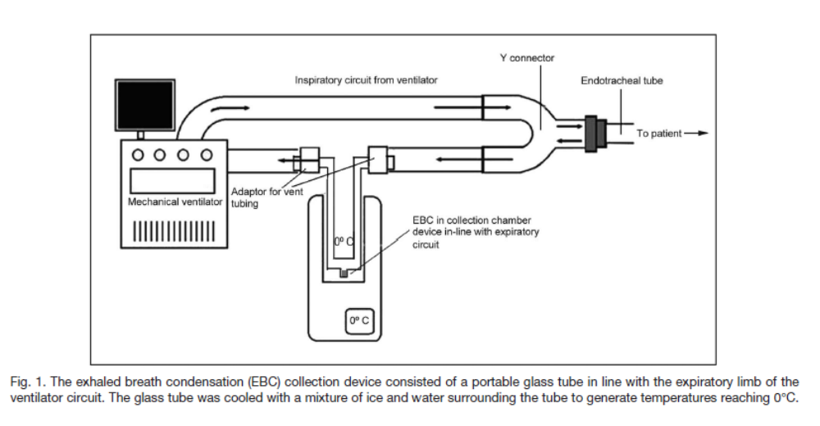
Figure

Slide 229
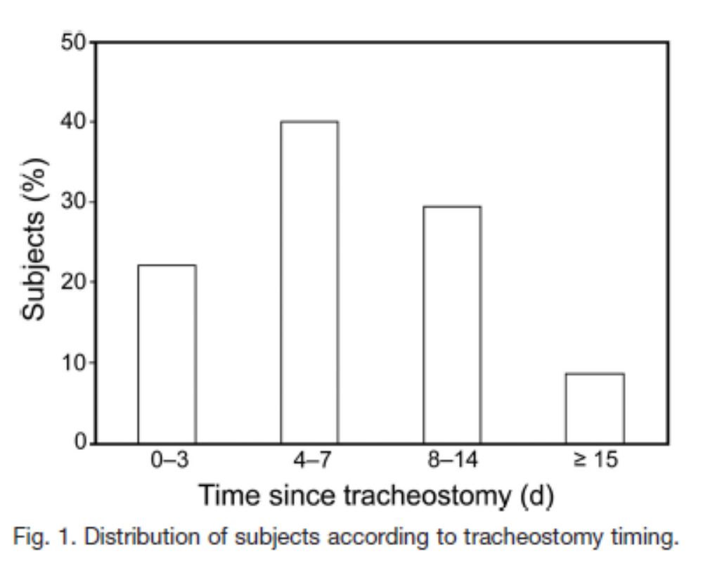
Bar Chart

Slide 230
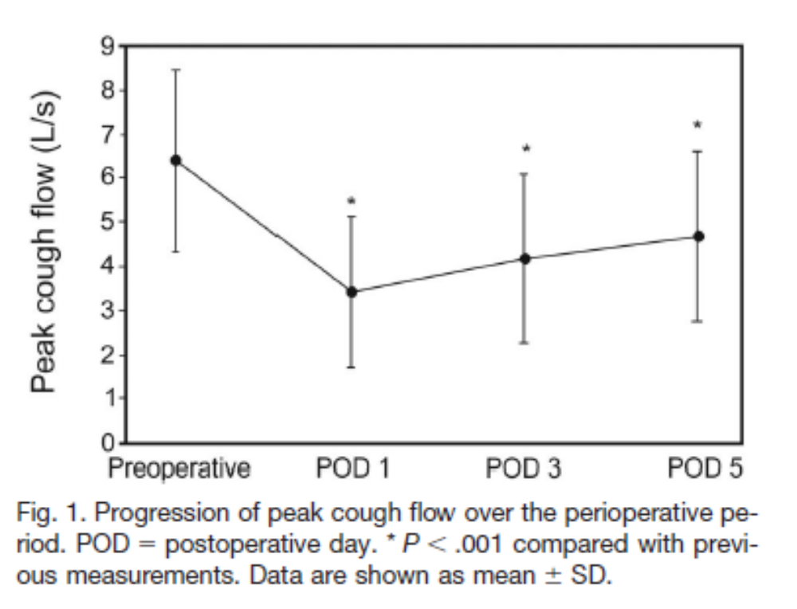
Line Chart

Slide 231
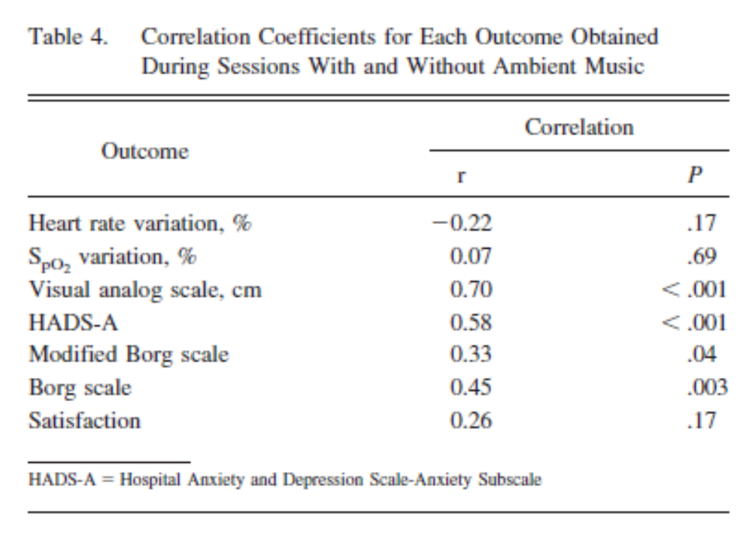
Table

Slide 232
Research Article Structure/content
General Author’s checklist
Does the paper fit a publication category?
Does the cover letter meet specifications?
Complete title?
Double-spaced?
Proper page numbering and indentation?
Are references, figures, and tables cited in the text?
Are all references in the requested style?
Arithmetic checked?
Generic names of drugs provided?
Fully proofread?

Slide 233
Referencing
AMA article
  Author1 FM, Author2 FM. Title of the article with only the first word capitalized. Journal abbreviation YEAR;journal(number):pages.
AMA book
  Author1 FM, Author2 FM. Title of Book with First Letters Capitalized. Ed #. City,State:Publisher;YEAR.
AMA chapter in edited book
  Author1 FM, Autor2 FM. Title of Chapter with First Letters Capitalized. In: Author1 FM, Author2 FM eds. Title of Book with First Letters Capitalized. Ed #. City,State:Publisher;YEAR:pages.
See AMA Manual of Style; RCJ Author Information online

Slide 234
Referencing
APA article
  Author1, F.M., & Author2, F.M. (YEAR). Title with first word capitalized. Journal Title, journal(number),pages. doi:
    A digital object identifier (DOI) is a unique alphanumeric string assigned by a registration agency (the International DOI Foundation) to identify content and provide a persistent link to its location on the Internet. The publisher assigns a DOI when an article is published and made available electronically.
  See: Publication Manual of the American Psychological Association

Slide 235
Referencing
Internet source rules
  Cannot be a home page
  Can be accessed by anyone
  Citation contains as much specific information as possible
  Include date of access
Use the format in “Instructions to authors”
  Author FM. Productivity at work improved for sleep apnea patients using CPAP. Medical News Today: April 15, 2013. http://www.medicalnewstoday.com/releases/259016.php Accessed January 27, 2015.

Slide 236
Documenting Sources Using References
Any background information not known as “general knowledge”
  Information form articles
Footnotes at the bottom of each page; not used in RCJ
Endnotes (references) follow the text
  End of text
  Acknowledgements
  References
  Appendices

Slide 237
Copyrighted Material, Fair Use, Public Domain
Cite all materials, whether copyrighted or in PD
Copyrighted material may be used without the permission of the author for “fair use”
  As a reference in a paper
  A copy may be made for personal use
  Research, teaching news reporting
  Violation results in a fine
Public Domain
  Government documents (EPR-3)
  Copyright has expired
  Acknowledge, cite
When in doubt, ask!
  royalties

Slide 238

Mistakes to Avoid
Research question not described or hypothesis not clearly explained
Research hypothesis not actually tested
Wrong measurement tools
Sample too small, results inconclusive
Wrong design for the question; confounding variables not controlled

Slide 239

Mistakes to Avoid
Incorrect statistical analysis
Unjustified conclusions
Conflict of interest
Poor grammar and spelling

Slide 240

Things to Remember
Logical continuity
Avoid preconceived notions
Follow an outline
Enough detail for others to replicate
Repeat measurements
Assure and document calibration procedures

Slide 241

Things to Remember
Report only the data collected
Proofread after a period of time
Submit a carefully prepared manuscript; use the checklist

Slide 242
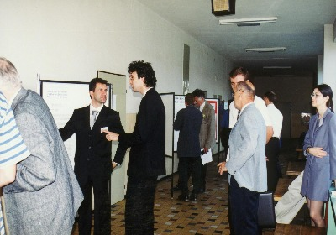
Poster Presentations
Allow direct communication with authors
Dialogue may stimulate new ideas
Open session or poster symposium
  Poster is displayed
  Interested parties “make the rounds”
  Authors make a brief presentation of why they did the study and its impact
  Question and answer session

Slide 243

Discussion Points
The function of poster presentations
What to include in the poster
Presentation of text and data
Poster format and design
Practical aspects of poster construction
Transporting your poster
Presentation
Common mistakes

Slide 244
The Function of Poster Presentations
Convey scientific information and views in a visual format, to an interested audience
Enable more researchers to present their ideas
Stimulate further research
Promote collaboration among researchers
Allows time for intensive discussion, comments and questions
Provide opportunity to be invited to speak at other meetings
Supports promotion and tenure
Promotes your reputation
Impresses your peers

Slide 245
A Poster Includes…
Text
Guides the reader through the findings
Logically links the sections
Must be kept brief, to promote visual elements
Avoid references unless directed to include them
Graphics
Charts
Diagrams
Graphs
Maps
Photographs
Tables

Slide 246
A Poster Includes…
Three-dimensional material
Devices
Handouts
Attached with double-sided tape or Velcro strips
Avoid large or heavy attachments
  photograph

Slide 247
Presentation of Text
Typed or printed
Never handwritten
Base on an expansion of the abstract, rather than a reduction of the manuscript
Keep paragraphs short (10-20 lines)
Use bulleted lists to reduce continuous runs of text
Keep text brief!

Slide 248
Fonts and Alignment
Font must be easy to read
Serif fonts (Times New Roman, Courier, Palatino)
Sans-serif fonts (Helvetica, Arial, Century Gothic)
Do not use ornate or novelty fonts
Flush left, ragged right or justified; be consistent throughout the poster

Slide 249
Font Size
Title: 90 pt., bold
Subtitles: 72 pt.
Section titles: 60 pt.
Text 18-24 pt.

Slide 250
Headings
Used to direct the viewer and organize
Use a hierarchy of styles (type size and weight)
Bold/not bold
Heading, subheading, sub-subheading

Slide 251
Line Length and Spacing
Single space
20-60 characters per line
Line spacing should be 20% of the type height
Space between paragraphs or indent

Slide 252
Profread
Proofreed
Proofread

Slide 253
KEEP TEXT BRIEF

Slide 254
Presentation of Data
Tables, graphs, bar charts, pie charts (Excel)
Keep them as simple as possible
Allows viewers to visualize and assimilate data
Do not bury graphics within columns of text
Do not include tables of raw data

Slide 255
Positioning and Organization of Graphic Elements
Follow the same columns as text
Provide clear space between graphics and text
Always refer to them in the text
Number and provide a legend to allow the graphic to be free standing
Legends may be above, under or beside graphics (be consistent)
Three-dimensional effects are effective as long as they do not “clutter”

Slide 256
Tables
Columns and rows have descriptive headings
Include units of measure (mL, L/min) in the headings
Notes are placed under the table, keyed with symbols (* ' &)
Format according to desired journal
Do not include gridlines

Slide 257
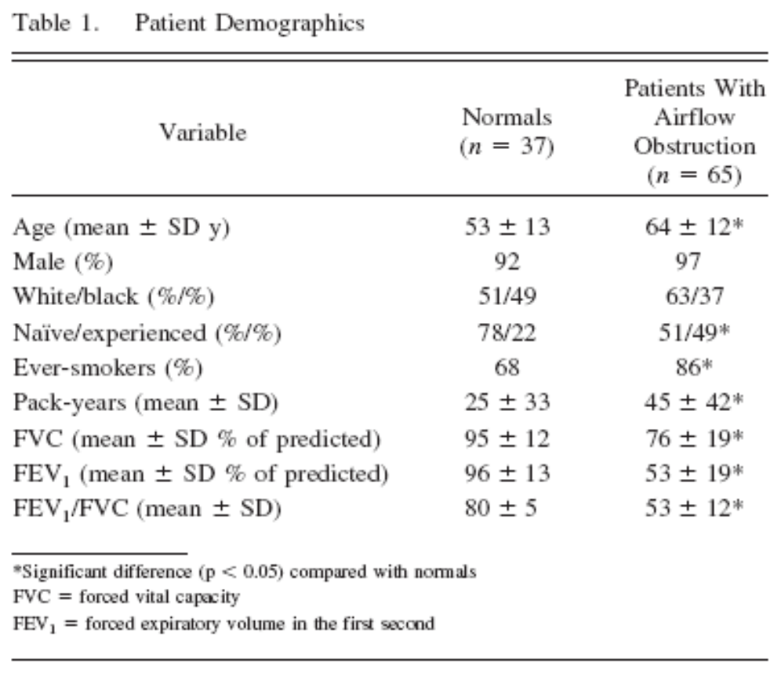

Slide 258
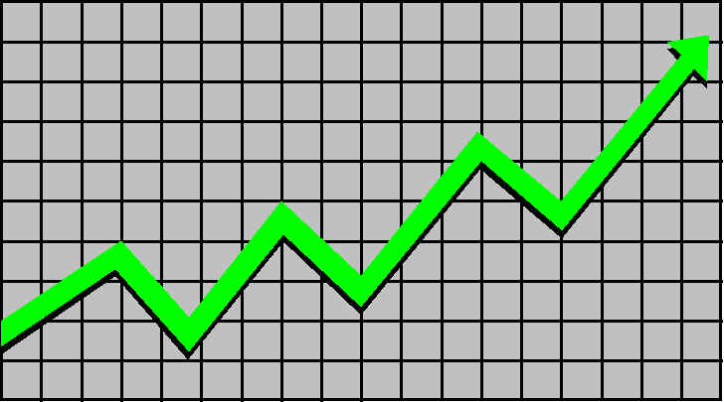
Graphs
Display trends
Use different graph lines for each set of data
Maintain consistent labeling
Restrict to < 3 lines
Provide a legend

Slide 259
Charts
Bar
Simple vertical and horizontal
Y-axis centered allows positive and negative data shifts
Stacked vertical illustrates cumulative data
Three-dimensional is more interesting
Provide a legend
Pie
< 6 sections
Most important section at 12 o’clock
Arrange sections from largest to smallest
May be shadowed, doughnut, three-dimensional, or pulled-apart
Limited only by the imagination!

Slide 260
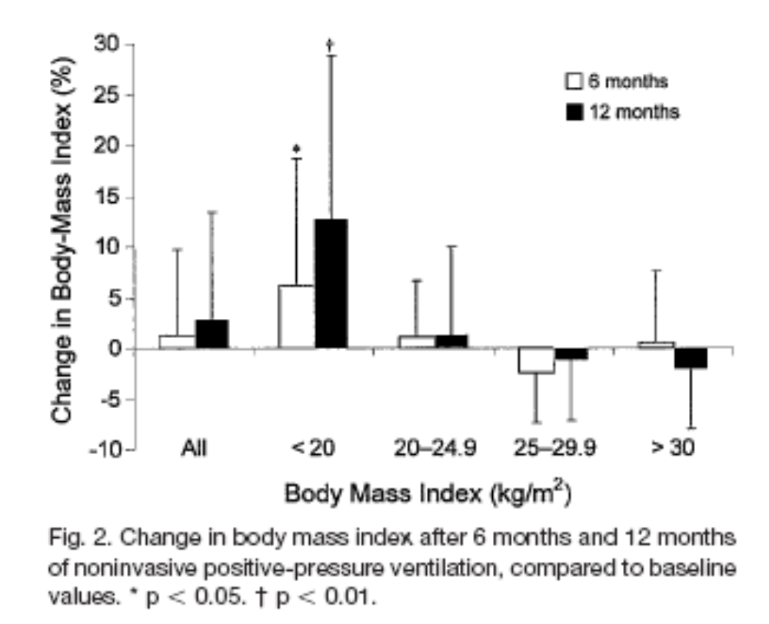

Slide 261
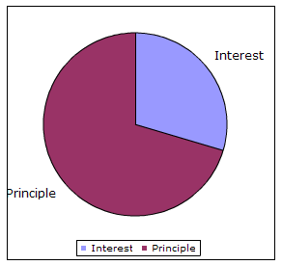

Slide 262
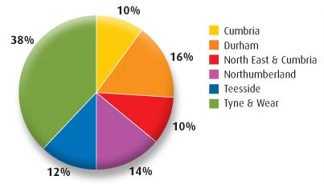

Slide 263
Photographs
Must be directly relevant
Very clear and professional
Discernable from 3-6 feet
Minimum 5”x7”, matte finish
Avoid extraneous materials/people
Have permission from subjects

Slide 264
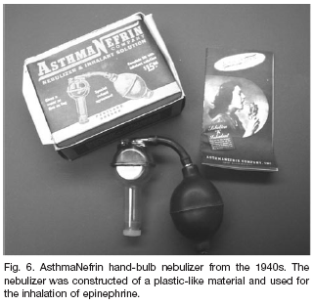

Slide 265
Poster Format and Design
Title
Announces you and your work
Should be seen from 18-30 feet away
Legible, assertive, clear, eye-catching
Author’s name(s) and affiliation (smaller)
Affiliation logo
Position at the top of the poster
Bold, 25-45 mm lettering
Strong contrast from the background
Upper and lower case lettering
Often conveys the take-home message

Slide 266
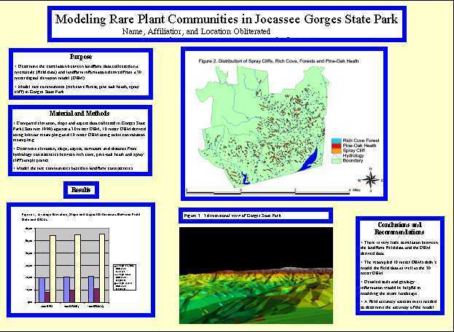

Slide 267
Poster Format and Design
Abstract
Optional
Check the rules
All the information is on the poster
Introduction
Justify the research
Present the aims of the study
Research question or hypothesis
Bullet points, color, or bold type may help emphasize the objective of the study
Suggested length < 200 words

Slide 268
Poster Format and Design
Methods
Be concise
Sufficient information to allow viewers to determine validity
A diagram, photo, device, or flow chart may be useful to illustrate an experimental setup
Applicable statistical tests and p values are specified
Suggested length < 200 words

Slide 269
Poster Format and Design
Results
Presents the data supportive of your finding
Avoid raw data
Use charts and tables
Minimize text (< 200 words)

Slide 270
Poster Format and Design
Conclusions
May restate hypothesis
Clear and concise bulleted list
Suggested length
< 300 words
Discussion and references
Not usually necessary unless specified by organization
Conclusions section makes the major points

Slide 272
Poster Format and Design
Further information
Provide your email address
URL where they can download a PDF of your poster

Slide 273
Summary of Poster Elements
Title, Authors and Affiliations
Introduction
Methodology
Results
Conclusions
Contact information
Check organization’s specifications

Slide 274
Poster Layout
Determine the dimensions of the space available
Often 4’ x 6’ or 4’ x 8’
Organize elements in 2-6 vertical strips
Avoid a layout of text rectangles with too-small print or small pieces mounted separately
Enlist the aid of a graphics designer in the medical education department
Print and ship companies allow flexibility

Slide 275
Computerized Layout and Printing
Greatest visual appeal
Flexibility in layout
Any visual feature may be included
Use Power Point to create and download to a print/mail service:
http://www.postersession.com/home.html
Cost
Once done, extra expense to change

Slide 276
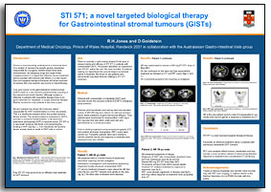

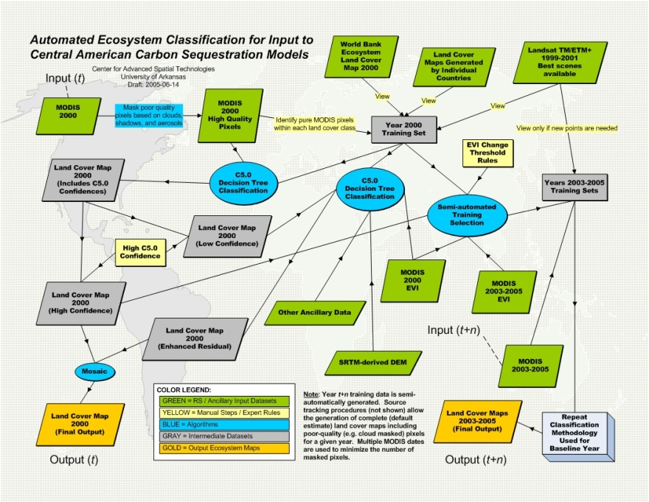
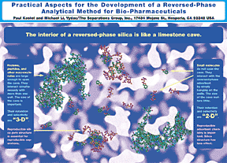

Slide 277
Manual Layout and Printing
Print font and weight
Title, authors and affiliations on a banner
Print each section on good paper
Clear tables and illustrations
Mount on posterboard
Arrange in 3-4 columns
Incorporate blank space
Very labor/skill intensive

Slide 278


Slide 279
Layout Checklist
Right size and shape for the display board
Title easily seen in a crowded room
Authors and their affiliations clearly visible
Visual impact
Pleasing to the eye
Clear visual central focus
Text easy to read
Easily navigated
Scientific message clear and succinct
Credible and professional
See example at NCSU site

Slide 280
Practical Aspects of Manual Poster Construction
Backing material
Usually cardboard
Choose colors carefully
Be sure cutting tools are sharp
Use a straight edge
Measure twice, cut once

Slide 281
Practical Aspects of Manual Poster Construction
Paper
Use high quality heavy paper
Marker paper is recommended, since inks do not bleed
Drawing
Use a computer
Use a designer/artist
Clean, professional drawings

Slide 282
Practical Aspects of Manual Poster Construction
Adhesives
Double-sided tape
  Useful for mounting photographs
  May be a slight bleed-through on thin papers
Aerosol adhesives (i.e. 3M Photomount)
  Read label for intended use
  Easy to use
  Won’t bleed through
Rubber cement
  Leaves blobs
  Bleed through
Glue pens and sticks
  Easy to use
  Fast adhesion
  Bleed-through varies

Slide 283
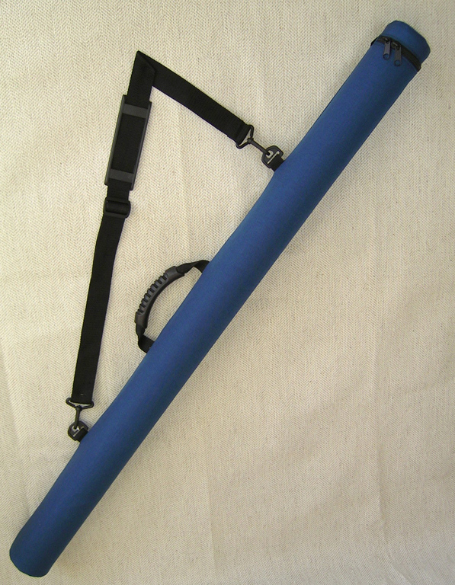
Poster Transportation
Computer generated posters are rolled, placed in a tube
When on individual cardboard backing sheets, poster is carried in a portfolio
Do not fold
Best if you can use overhead bin

Slide 284
Poster Assembly
Arrive early
Align rows and columns precisely
Align components vertically and horizontally
Assure spaces between components are equal
Firmly attach components to the display board
Title is high on the board
Main body is between eye and waist height
Borders are equal on the display board
Bring a tape measure, ruler, and right angled triangle
Already done if a one-piece poster

Slide 285
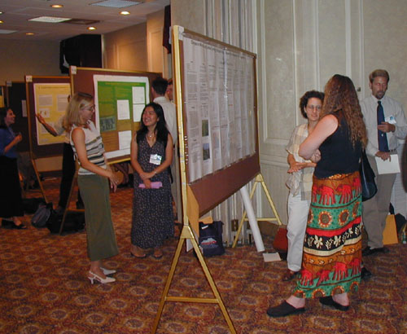

Slide 286
Poster Presentation/Repair Kit
Mounting pins
Spray or putty adhesive
Velcro tape
Markers
Business cards
Supplementary information sheets
Miniature poster copies
Correction fluid
Scissors
Masking tape
Art knife

Slide 287
The Poster Presentation
Organizations allow 2-5 minutes for presentation to an interest group
Individual presentations at the poster
Have a script and practice
Introduce yourself
Wear your name tag
Guide the viewer through the poster

Slide 288
The Poster Presentation
Present why the research was done
Present the most important points
Discuss ideas for future work
Address questions
Thank viewers for visiting
Offer a card or poster copy

Slide 289
Professional Image
Body language
Professional attire
Grooming
Eye contact
Voice
Confidence
Positive attitude
Stay with your poster

Slide 290
Things to Avoid
Nervousness
Fidgeting
Loud clothing
Distracting jewelry
Chipped nail polish
Overpowering cologne
Chewing gum
Poor posture

Slide 291
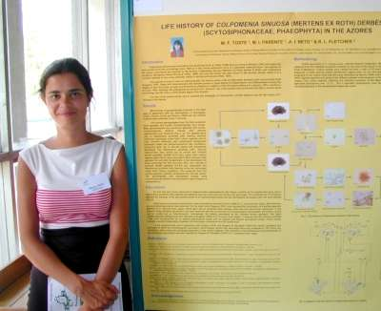


Slide 292
Common Poster Mistakes
Failure to allow enough time
Title smaller/larger than necessary
Poster overflows the space available
Too much text
Crowded elements
Varying column lengths
Lack of unity of style
Presentation too low on the poster board
Clutter
Text too small
Overpowering use of background graphics
Neglect

Slide 293
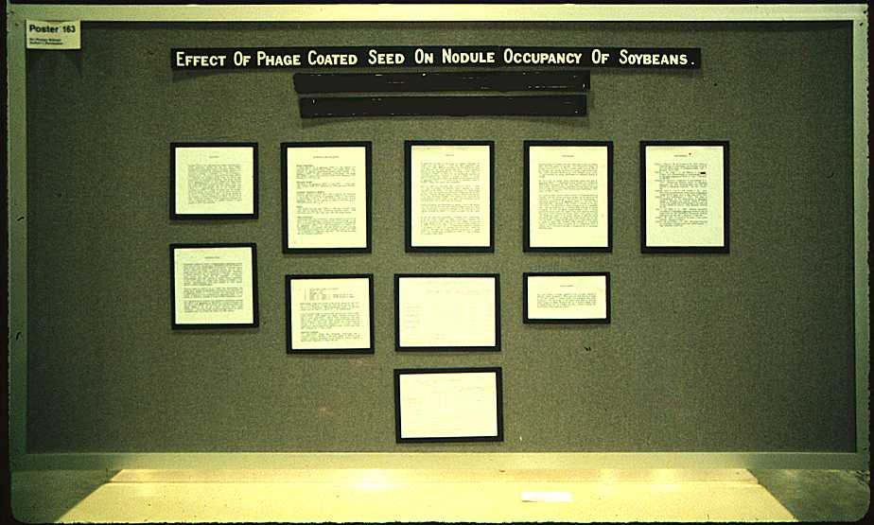

Slide 294
Poster Evaluation

Slide 296


Slide 297


Slide 298
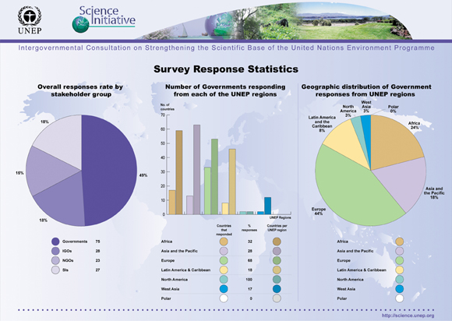

Slide 299
Resources
Poster printing:
  http://www.sciencepresentations.com/index.html
  Your university or hospital’s instructional media center
  http://www.largeformatposters.com/
A company that gives you a Power Point template to cut and paste into, prints your poster, and ships it to you:
  http://www.postersession.com/home.html

Slide 300
Resources
A poster how-to from North Carolina State University and Oregon State University:
  http://www.ncsu.edu/project/posters/IndexStart.html
A more humorous, but very good guide to postering:
  http://www.swarthmore.edu/NatSci/cpurrin1/posteradvice.htm

Slide 301
Resources
More postering information:
  http://www.ce.umn.edu/~smith/supplements/poster/guide.htm
An oft cited book on poster presentations and my outline for this presentation:
  Gosling PJ. Scientist’s guide to poster presentations. New York: Kluwer Academic/Plenum Publishers, 1999.

Slide 302
Interpreting the Literature
Process of integrating, synthesizing and summarizing information obtained from different sources into a recommendation for application in practice
Integrative literature
  Systematic reviews, overviews, meta-analyses, practice guidelines, decision analyses, cost-effectiveness analyses

Slide 303
Evaluating the Literature
What is the source (journal) of the article?
  Reputation
  citation rate/impact factor; RCJ 1.838
    a measure reflecting the average number of citations to recent articles published in that journal.
  AJRCCM: 13
Was the publication peer reviewed?
  Almost all are that are in scientific journals
  Critical evaluation by someone familiar with the topic
  Confidence of soundness, validity, conclusions fit the findings

Slide 304
Evaluating the Literature
Who are the authors and what are their affiliations?
  Some authors are particularly well known in their area
  Some institutions are well-known for the authority of their research
What/who is the main subject of the study?
  The problem investigated
What problems were investigated?
What is the purpose or rational for the study?
  Why?

Slide 305
Evaluating the Literature
Who or what constituted the sample?
  To extrapolate data and apply them outside a study, the characteristics of the sample must be evident and comparable to the population from which the sample is selected
What was the design of the study?
  Methodology
  Described in enough detail to allow the reader to make conclusions about the results and applications
What were the statistical analyses?
  Appropriate for the data type and study design?

Slide 306
Evaluating the Literature
What are the results?
  What did they find?
  Are the results of the study consistent with the study design and analyses?
Are the results clear?
  Do the results have meaning to the intent of the study?
  Understandable?
Did the results answer the research question/address the hypotheses?

Slide 307
Evaluating the Literature
Do the results seem valid?
  Do the results make sense?
Are the interpretations of the results consistent with the study design and analyses?
  Authors make the correct conclusion from the data, consistent with the type of information provided by the study design
Are the results consistent with findings from similar studies?
  What did you learn from other similar studies?
  May not always be congruent
  Why you did a literature review

Slide 308
Evaluating the Literature
What do the results mean to medicine and health care, and you and your patients?
  May be the most important
Can the results be applied to your research or clinical practice?
  Consider if they can be applied to what you do

Slide 309
Ethics and Research
Institutional review and human subjects’ rights
Institutional Review Board
Informed consent
Ethical Issues

Slide 310
Institutional Review Board
No human subjects research may be initiated without IRB approval
Protects the rights, well being, and privacy of individuals and the interests of the institution
Regulations set forth by the US DHHS
http://southmed.usouthal.edu/com/research/humansubjects.html

Slide 311
What research must be reviewed?
It is the policy of the University of South Alabama that all faculty and staff, both full-time and part-time, and students (whose research is conducted under the sponsorship of a faculty member) using human subjects to conduct research within the course and scope of their duties, regardless of the source of funding or even when no funds are involved, are required to have prior approval from the IRB before research is initiated. This includes medical record reviews, surveys, studies of pathological and/or diagnostic specimens, compassionate use studies, and exempt studies.

Slide 312
Conditions for approval
1. The risks to the research subject are so outweighed by the sum of the benefit to the subject and the importance of the knowledge to be gained as to warrant a decision to allow the subject to accept these risks
2. Legally effective informed consent will be obtained by adequate and appropriate means
3. The rights and welfare of any such subjects will be adequately protected

Slide 313
Composition of the IRB
Diverse backgrounds
Those informed of research applications, law and standards
Both sexes
Knowledge of handicapped or retarded children
Behaviorists
Non-scientists
Multiple professions
An unaffiliated public member
Concerned with the welfare of the vulnerable
Specialists
Continuing reviewers without conflict of interest

Slide 314
Components of the IRB Proposal
Purpose and procedures
Risks and benefits
Description of how data will be handled to assure subject anonymity
Statement that the subject may withdraw without prejudice
Name and number of the investigator
Completed informed consent form
Available alternative procedures and therapies
Subjects right to treatment or compensation in the event of research-related injury

Slide 315
Informed Consent
Voluntary permission given by the subject after being informed of the purpose, methods, risks, and benefits
Failure to obtain IC is battery or negligence
Subject may withdraw at any time without penalty

Slide 316
Ethical Issues
Respect for persons
  Researchers will endeavor to treat subjects as autonomous, self-determining individuals; incompetent patients are entitled to the protection they deserve
Justice
  All persons are to be treated fairly and equally
Beneficence
  Commitment to do no harm, maximize potential benefit, and minimize potential harms

Slide 317
The AARC Code of Ethics
Respect and protect the legal and personal rights of patients they care for, including the right to informed consent and refusal of treatment.
Divulge no confidential information regarding any patient or family unless disclosure is required for responsible performance of duty, or required by law.
Demonstrate behavior that reflects integrity, supports objectivity, and fosters trust in the profession and its professionals. Actively maintain and continually improve their professional competence, and represent it accurately.
Perform only those procedures or functions in which they are individually competent and which are within the scope of accepted and responsible practice.

Slide 318
AARC Code of Ethics
Provide care without discrimination on any basis, with respect for the rights and dignity of all individuals.
Promote disease prevention and wellness.
Refuse to participate in illegal or unethical acts, and refuse to conceal illegal, unethical or incompetent acts of others.
Follow sound scientific procedures and ethical principles in research.
Comply with state or federal laws which govern and relate to their practice.
Avoid any form of conduct that creates a conflict of interest, and shall follow the principles of ethical business behavior.

Slide 319
AARC Code of Ethics
Promote health care delivery through improvement of the access, efficacy, and cost of patient care.
Refrain from indiscriminate and unnecessary use of resources

Slide 320
Regulatory Protection of Human Subjects in Research
Objectives
Describe, discuss, and define the history of protection of human subjects
Describe and discuss the need for protection of human subjects
Outline and discuss the Belmont Principles
Describe the functions of the IRB
List the elements of informed consent

Slide 321
Protection of Human Subjects
Paramount importance
Highly regulated
  Federal
  State
  Local
Covers all human research
  Expanded authority beyond biomedical
  Different levels of approval

Slide 322
Institutional Review Board
Scientists
Non-scientists
Members not affiliated with institutions
Representatives of special populations
Purpose: protect human subjects

Slide 323
Important Points
The following is intended to be a general overview
Institutions and local IRBs may have variations on what is presented
Know your institutional requirements

Slide 324
Overview
What needs IRB approval?
Categories of research
How to determine which category to use
Principal investigator responsibilities

Slide 325
What Needs IRB Approval?
Human research must be reviewed and approved by the IRB before research is started
What is human research?
  There are two definitions of human research that must be considered. If the activity meets either definition, it must be approved by the IRB
    Department of Health and Human Services (DHHS)
    Food and Drug Administration (FDA)

Slide 326
DHHS Definition of Human Research
  Is the activity research?
  Does the research involve human subjects?
  Is this human research exempt from IRB approval?

Slide 327
DHHS
Human-subjects research
  Is the activity research?
    Research—systematic investigation designed to contribute to generalizable knowledge
    Systematic investigation—use of a clear plan, system, or method to conduct a detailed examination or inquiry for facts
    Generalizable knowledge that is universally or widely applicable (expressed, for example, in theories, principles, and statements of relationships)

Slide 328
DHHS
Human-subjects research
  Is the activity research?
  Does the research involve human subjects?
    A human subject is:
    A living individual about whom an investigator (whether professional or student) conducting research obtains:
      data through intervention or interaction with the individual
      identifiable private information

Slide 329
DHHS
Human-subjects research
  Is the activity research?
  Does the research involve human subjects?
  Is this human research exempt from IRB approval?
    Examples of exempt research are: research on educational strategies or curricula, surveys or interviews of adults, retrospective chart reviews
    Does “exempt” mean I don’t need IRB review?
      No, all exempt research requires the IRB to make the exempt determination

Slide 330
FDA Definition of Human Research
Human-subjects research
  Is the activity a clinical investigation?
  Does the research involve human subjects?

Slide 331
FDA Definition of Human Research
Human-subjects research
  Is the activity a clinical investigation?
    An activity is research if it involves an
    FDA-regulated test article

Slide 332
FDA Definition of Human Research
Human-subjects research
  An FDA-regulated test article is involved if one of the following conditions applies:
    It involves the use of a drug, other than the use of a marketed drug, in the course of medical practice
    It involves the use of a device to evaluate safety or effectiveness of that device
    Data from the activity will be submitted to, or
    held for inspection by, the FDA in support of
    a marketing or research application for an
    FDA-regulated product

Slide 333
FDA Definition of Human Research
Human-subjects research
  Is the activity a clinical investigation?
  Does the research involve human subjects?
    Research involves human subjects if:
      The test article will be used on one or more humans; or
      The data obtained from controls (or from the use of the device) will be submitted to, or held for inspection by the FDA in support of a marketing or research application for an FDA-regulated product

Slide 334
FDA Definition of Human Research
Human-subjects research
  Is the activity a clinical investigation?
  Does the research involve human subjects?
  Research involving a test article cannot be “exempt” under FDA regulations

Slide 335
Four Types of Review
Not research or nonhuman research
Exempt from review
Expedited IRB review
Full IRB review

Slide 336
Four Types of Review
Not research or nonhuman research
  Not an IRB approval (only IRB determination)
  No expiration
Exempt human research
  Not an IRB approval (only IRB determination)
  No expiration

Slide 337
Four Types of Review
Expedited human research (nonexempt)
  Must be minimal risk
  Research must fit into one of seven categories (e.g., blood draws, surveys, chart reviews)
  Reviewed by a single member of the IRB
  Approved for up to one year
  Requires annual review

Slide 338
Four Types of Review
Full board human research
  Greater than minimal risk or is not eligible for expedited review (does not fit into one of the seven categories for expedited research)
  Must be reviewed by a convened meeting of
  the IRB
  Approved for up to one year
  Requires annual review

Slide 339
IRB Required Training
Ethics training is a federal requirement of institutions that hold an assurance to conduct human-subjects research
All investigators and research staff conducting non-exempt human research at institutions may complete research ethics training provided by the Collaborative Institutional Training Initiative (CITI Program) at the University of Miami
Check with your IRB office for training information

Slide 340
PI Responsibilities
Obtaining IRB approval:
  Initially
  Annually (submit progress report for continuing review and reapproval of nonexempt research)
  Ongoing for modifications (submit amendments)

Slide 341
PI Responsibilities
Tracking adverse events
Reporting unanticipated problems
Reporting noncompliance
Inactivation

Slide 342
Initial and Continuing Review
IRB may approve a study for a period
of no longer than one year

Slide 343
Initial and Continuing Review
For reapproval, the IRB must review:
  The protocol
  Any amendments
  A status report including:
    Number of subjects accrued
    Description of adverse events, unanticipated problems, withdrawal of subjects, complaints
    Summary of relevant information
    Copy of current consent document(s)

Slide 344
Modifications
Changes in approved studies cannot be made without prior IRB review and approval
  Except when necessary to eliminate
  immediate hazards to a subject

Slide 345
Modifications
Sample changes requiring IRB approval are changes in:
  Number of subjects in consent
  Design, methods, or procedures
  Study staff or study sites/locations
  Consent procedures or consent documents
  recruitment advertisements or payments

Slide 346
Unanticipated Problems
Any incident, experience, or outcome that meets all of the following criteria:
  Unexpected (in terms of nature, severity, or frequency)
  Related, or probably related, to participation in the research (more sure than unsure)
  Suggests that the research places subjects or others at a greater risk of harm (including physical, psychological, economic, or social harm) than was previously known or recognized

Slide 347
Unanticipated Problems
If the event represents a UPIRSO, prompt reporting to the IRB is required:
  Within 7 days if UPIRSO is based on internal information
  Within 14 days if UPIRSO is based on external information

Slide 348
Reporting Noncompliance
Conducting research in a manner that disregards or violates:
  Federal regulations
  IRB requirements and determinations
  Institutional policies and procedures
Report is submitted by the PI and reviewed by a convened IRB

Slide 349
Reporting Noncompliance
Findings of serious or continuing noncompliance are reported to:
  OHRP (HHS-supported)
  FDA (IND/IDE)

Slide 350
Inactivation
When is it appropriate to inactivate IRB approval?
  Enrollment is permanently closed to new subjects
  Data, private information, and/or clinical specimens are no longer being collected for research purposes (including long-term follow-up)

Slide 351
Inactivation
When is it appropriate to inactivate IRB approval?
  Subjects are no longer being treated under the research protocol (includes no plan for future research treatment)
  Research assessments or procedures are no longer being performed (includes no plan for future research procedures)

Slide 352
Inactivation
When is it appropriate to inactivate IRB approval?
  Data/specimen analysis has been completed locally, or if analysis continues locally and the data has been permanently deidentified (key to code is destroyed or archived)
  Federal research funding for this study is closed (if applicable)
  The study is closed at all participating sites

Slide 353
Summary of Investigator Responsibilities
Obtain IRB approval
Follow the approved protocol
Supervise the study staff to make sure they are following the protocol

Slide 354
Summary of Investigator Responsibilities
Follow the regulations and policies related to research and privacy
Supervise staff compliance with policy
Protect participants
Verify IRB approval

Slide 355
Summary of Investigator Responsibilities
Keep participants informed and ensure they are willing to continue participation
Regularly collect and assess information about safety or unexpected problems
Assure study staff is qualified to perform delegated tasks (education, training, experience)

Slide 356
Summary of Investigator Responsibilities
Provide ongoing communication with staff
Confirm that the data are accurate
Maintain organized records

Slide 357
Ethical Guidance
There are many, but, in particular, you may recall:
  Hippocrates
  Nuremburg code
  Declaration of Helsinki (1964, 1975, 1983, 1989)
  NBAC
  Belmont Report
  Ref: Belmont Report, http://ohsr.od.nih.gov/guidelines/belmont.html

Slide 358
Declaration of Helsinki (1964, 1975, 1983, 1989)
Divides these activities into two basic categories:
  Standard medical care or treatment
  Research, which is further divided into
    Medical research combined with clinical care (clinical research), usually referred to as "therapeutic research”
    Nonclinical biomedical research, usually referred to as nontherapeutic research
    Ref: American Bioethics Advisory Commission Page 4 of 16 http://www.all.org/abac/dni004.htm 1/7/2010

Slide 359
Belmont Report
Identifies three basic ethical principles,
the “Belmont Principles”
  Respect for persons
  Beneficence
  Justice
These three have equal moral force
Ref: Belmont Report, http://ohsr.od.nih.gov/guidelines/belmont.html

Slide 360
Respect for Persons
Treat individuals as autonomous
Elements of autonomy include
  Mental capacity, the ability to understand and process information
  Voluntariness, freedom from the control or influence of others
  Provide extra protection to those with limited autonomy

Slide 361
Respect for Persons
Obtain informed consent
Respect the privacy of research subjects

Slide 362
Beneficence
“In this document, beneficence is understood in a stronger sense, as an obligation. Two general rules have been formulated as complementary expressions of beneficent actions in this sense: (1) do not harm and (2) maximize possible benefits and minimize possible harms.”
Use best possible research design
Make sure researchers are competent
Deny research without a favorable risk-benefit analysis

Slide 363
Justice
“Who ought to receive the benefits of research and bear its burdens? An injustice occurs when some benefit to which a person is entitled is denied without good reason or when some burden is imposed unduly.”
  Treat people fairly
  Design research so its burdens and benefits are shared equally
  Select subjects equitably
  Avoid exploitation of vulnerable populations

Slide 364
Risks
What is risk?
  IRB defines risk as the probability and magnitude of a harm (or injury) or discomfort
  Specifically, reasonably foreseeable risks or discomforts to the subject
    What becomes of those harms or untoward outcomes that were not reasonably foreseeable?
    What happens if those harms or untoward outcomes, or even the foreseeable risks, are of such a degree…

Slide 365
Risks
What is risk by regulation?
  §46.103(b) (5) introduces the term “unanticipated problems involving risks to subjects or others” but does not define it
  §46.109(e) in the description of continuing review uses the term “intervals appropriate to the degree of risk”, but does not define it

Slide 366
Benefits
What is a benefit?
  IRBs consider potential benefits as accruing to participants or society
  IRBs should consider only those risks and benefits that may result from the research (as distinguished from risks and benefits of therapies that subjects would receive if not participating in the research)

Slide 367
Benefits to Participant
In broad terms reasonably expected from research:
  Direct result of participation
    Expected potential benefits
      Direct benefit
      Secondary benefit
      Monitoring benefit
    Standard-of-care
    Experimental
    Unanticipated benefits
      Unexpected outcomes of planned procedures

Slide 368
Benefits to Participant
In broad terms reasonably expected from research:
  Indirect result of participation (social contact, sharing, personal satisfaction)

Slide 369
Benefits to Society
Societal benefit
  Generalizable beyond the general area or characteristics of the sample
Others
  Social groups
  Communities

Slide 370
Benefits IRBs Do Not Consider
  Generally, IRBs don’t consider indirect, unanticipated, or economic benefit, or benefit to others (such as to a local social group)
  Remember, societal benefits are OK
    PIs should still design research to increase indirect benefits, if possible, but they can’t do much to increase unanticipated benefits

Slide 371
Benefits
Federal regulations express it this way
  IRBs should not consider possible long-range effects of applying knowledge gained (i.e., possible effects of research on public policy) as among those research risks that fall within the purview of their responsibilities

Slide 372
In Closing
Know the rules
  Ignorance is not acceptable
  Ask, investigate, find out
Follow the rules
  Violations can be severe
Human subjects first
Know what you have to do before you begin

Slide 373
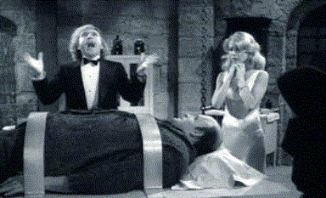
Go Forth and Research!

